Slide 1
HPA Tech Retreat
21 February, 2017

Slide 2
About NATO

Slide 3
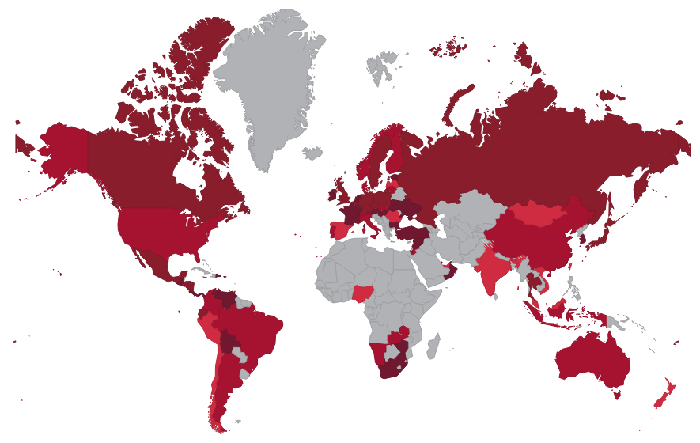
NATO: A Global Organization
638 COMPANIES
in
89 COUNTRIES
with
64,957 SCREENS
in
7,149 LOCATIONS

Slide 4
2016 Box Office Overview

Slide 5
2016 Global Box Office Comparison
Estimate: $38.1- $38.8 billion
$38.3 billion
Notes:
Global Box Office: There’s no “official” number yet…we usually go by what the MPAA says and they may not release that until March. An early estimated released by Deadline.com in January said $38.1 billion, and comScore recently told me $38.8 billion, but don’t attribute that to them publically. I would say this: “Estimates range between $38.1 billion-$38.8 billion. A final figure will be released in March.”

Slide 6
2016 Domestic Box Office Comparison
$11.13 billion
$11.37 billion
2015
2016
+2.13%
Source: comScore
Notes:
Global Box Office: There’s no “official” number yet…we usually go by what the MPAA says and they may not release that until March. An early estimated released by Deadline.com in January said $38.1 billion, and comScore recently told me $38.8 billion, but don’t attribute that to them publically. I would say this: “Estimates range between $38.1 billion-$38.8 billion. A final figure will be released in March.”

Slide 7
2001-2016 Domestic/International Box Office
Source: MPAA
Notes:
Global Box Office: There’s no “official” number yet…we usually go by what the MPAA says and they may not release that until March. An early estimated released by Deadline.com in January said $38.1 billion, and comScore recently told me $38.8 billion, but don’t attribute that to them publically. I would say this: “Estimates range between $38.1 billion-$38.8 billion. A final figure will be released in March.”

Slide 8
2016 Domestic Admissions Comparison
1.32 billion
1.314 billion
2015
2016
-.47%
Source: comScore

Slide 9
Domestic Box Office Comparison by Quarter
Source: comScore

Slide 10
Average Ticket Price
$8.65

Slide 11
Bottom Line
Exhibition is healthy
Trend is to a full-year “habit” of movie going

Slide 12
2016 Trends

Slide 13
2016: Percentages of Rated Films
Source: comScore

Slide 14
2016: Box Office by Rating
Source: comScore

Slide 15
Domestic vs. International Appeal
Domestic: $47.4 Million
International: $386.3 Million
Notes:
As is often the case with the globalization of our industry, some titles perform much better overseas than they do in N. America. The biggest example from this year: Warcraft $47.4 million domestic/$386.3 million overseas.

Slide 16
Home Entertainment Window

Slide 17
2004 Domestic B.O. vs. Home Entertainment
$24.9 billion
$9.29 billion
Source: comScore

Slide 18
2016 Domestic B.O. vs. Home Entertainment
$12.05 billion
$11.37 billion
Source: comScore

Slide 19
Upcoming NATO Meetings:
27-30 March 2017
Caesars Palace, Las Vegas

