Slide 1
Automating The Exchange Of Video Files
HPA 2017
Chris Lennon

Slide 2
The NABA DPP Project
File Delivery Specifications:
Focus: Delivery of HD Air-Ready Masters (MPEG-2, and AVC)

Slide 3
The NABA DPP Project
File Delivery Specifications
Commonly defined by major North American Broadcasters
In coordination with the Digital Production Partnership U.K.
Building upon their success in the U.K.
With the goals of
Reducing the number of Specifications
Improving interoperability by
Supporting Common Standards Based Technical Requirements
Removing Commonly Occurring Ambiguity
Removing Deviation from Standards Compliance
Removing Disparity- Differences that produce no Business Value

Slide 4
The NABA DPP Project
Commonly Defined, Standards-Based File Delivery Specifications
Two Major Sections
1. Technical Specifications
Video Codec Timecode Metadata
Audio File Format Captions
2. Appendix for Network / Broadcaster Specific Instructions
Appendix 1 Broadcaster-Specific Administrative Details
Contacts/ Delivery Methods/File Naming
Appendix 2 Broadcaster Specific Production/Post Production Requirements (Optional)
Production Quality Issues, Cameras, Graphics /Text/ Textless, etc.

Slide 5
The NABA DPP Project
File Delivery Specifications:
These are great for person to person exchange (they are PDFs)

Slide 6
The NABA DPP Project
File Delivery Specifications:
What About Machine-To-Machine Exchanges?

Slide 7
SMPTE’s Role
Standardize the exchange of content delivery specification elements
Useful for:
Transcoding
Business Systems
Quality Control Products

Slide 8
BXF’s Role
A known quantity
Already used widely for exchange of associated metadata:
Content Metadata
Content Transfer Instructions
Scheduling and As Run Data
Etc.

Slide 9
BXF’s Role
Focus on the core data elements from the NABA DPP Specs
Only those items that:
Might change
Are of interest to systems involved

Slide 10
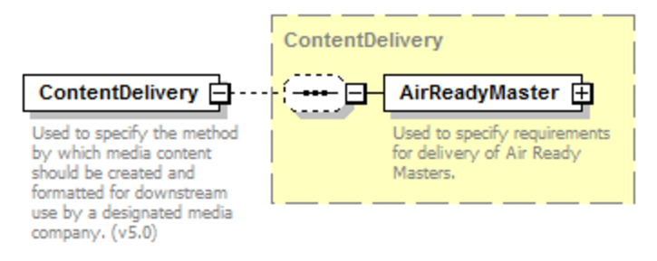
Structure

Slide 11
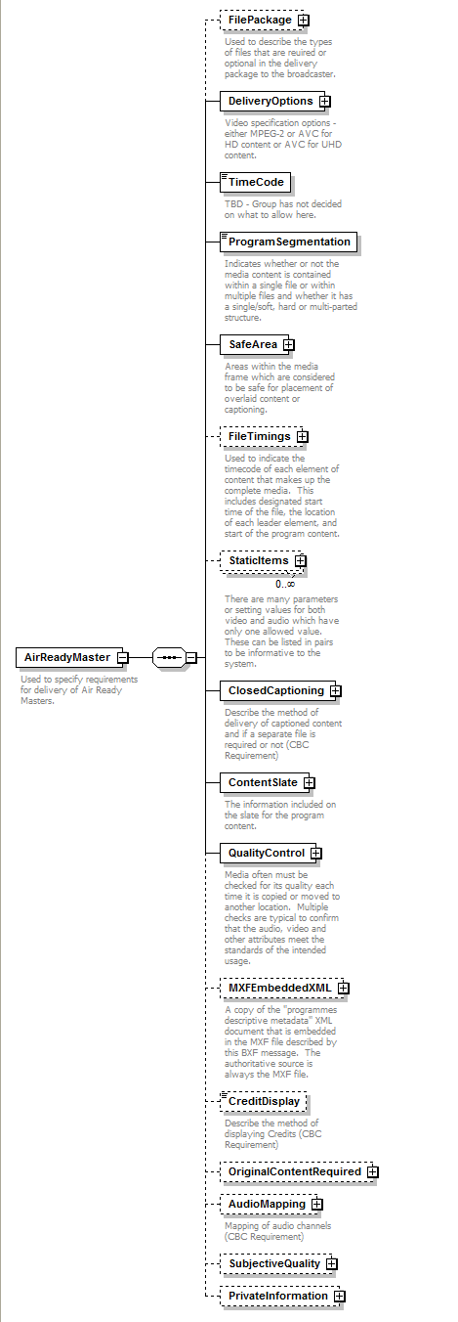
Structure
Let’s focus on the key bits

Slide 12
Structure
How would you like your file delivered?

Slide 13
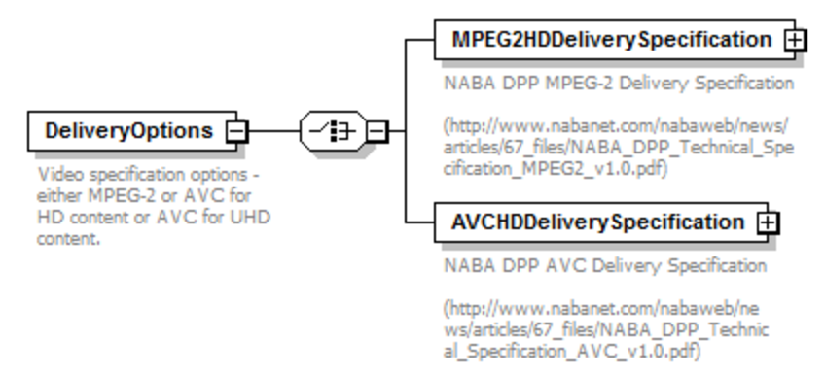
Structure

Slide 14
Structure
Corresponds to AS-11 X8 Technical Specification

Slide 15
Structure
X8 Specification specifies four options for encoding

Slide 16
Structure
Corresponds to AS-11 X9 Technical Specification

Slide 17
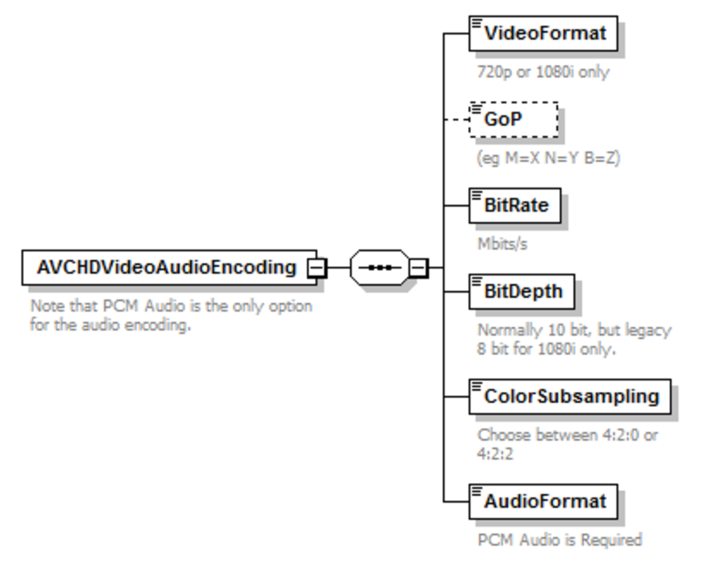
Structure
Aspects specific to AVC encoding only

Slide 18
Structure

Slide 19
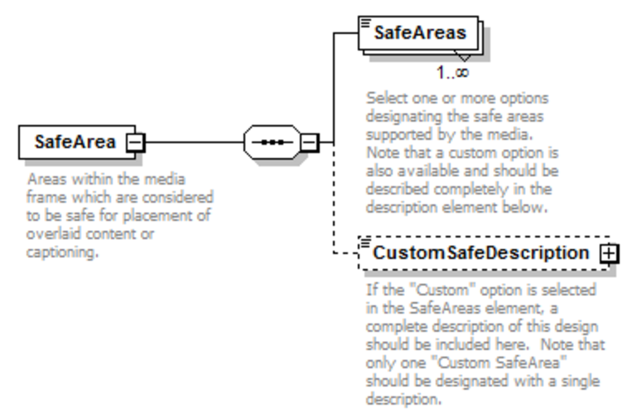
Structure

Slide 20
Structure

Slide 21
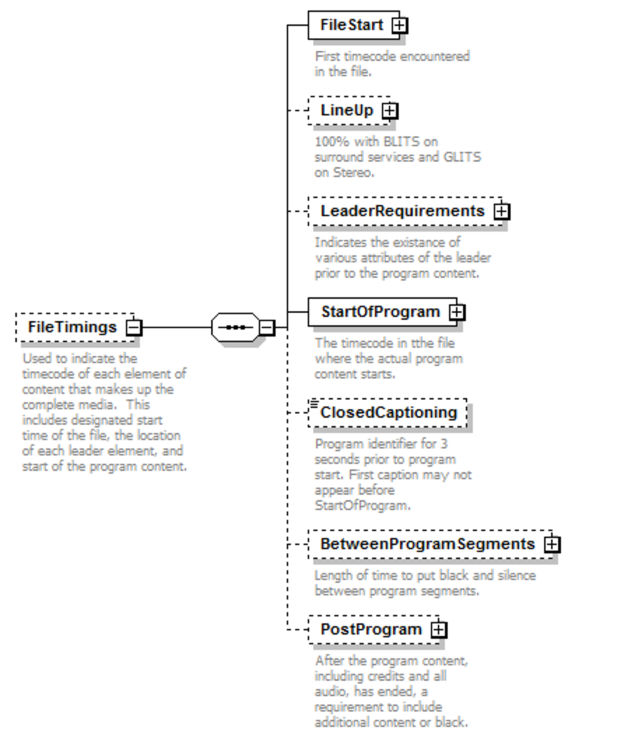
Structure

Slide 22
Structure

Slide 23
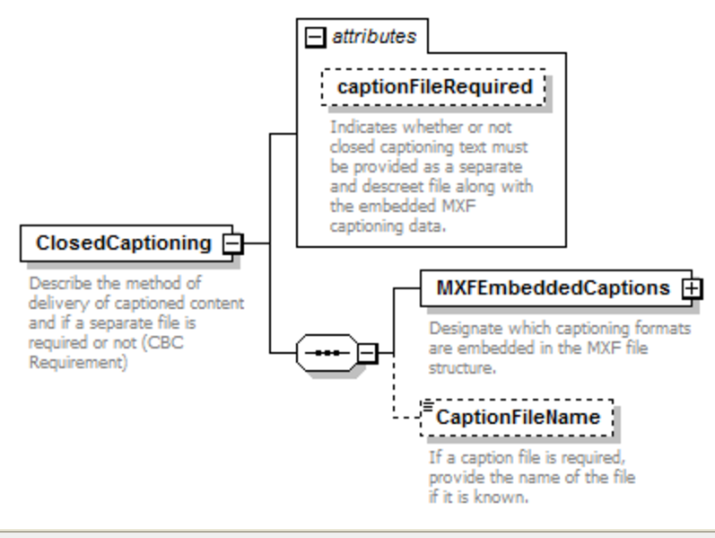
Structure

Slide 24
Structure

Slide 25
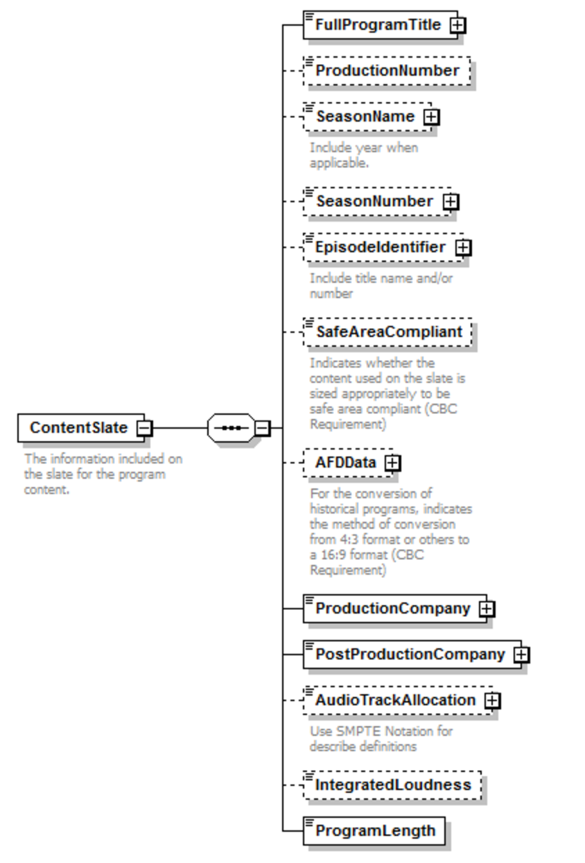
Structure
You want metadata?
We got metadata!

Slide 26
Structure

Slide 27
Quality Control
An area of expansion for BXF 5.0
Initiated at the behest of a vendor in this space
EBU.IO/QC team then looked at this work, and it filled a need
Harmonized:
BXF QC requirements
EBU QC requirements
NABA DPP Content Delivery Specification QC requirements

Slide 28
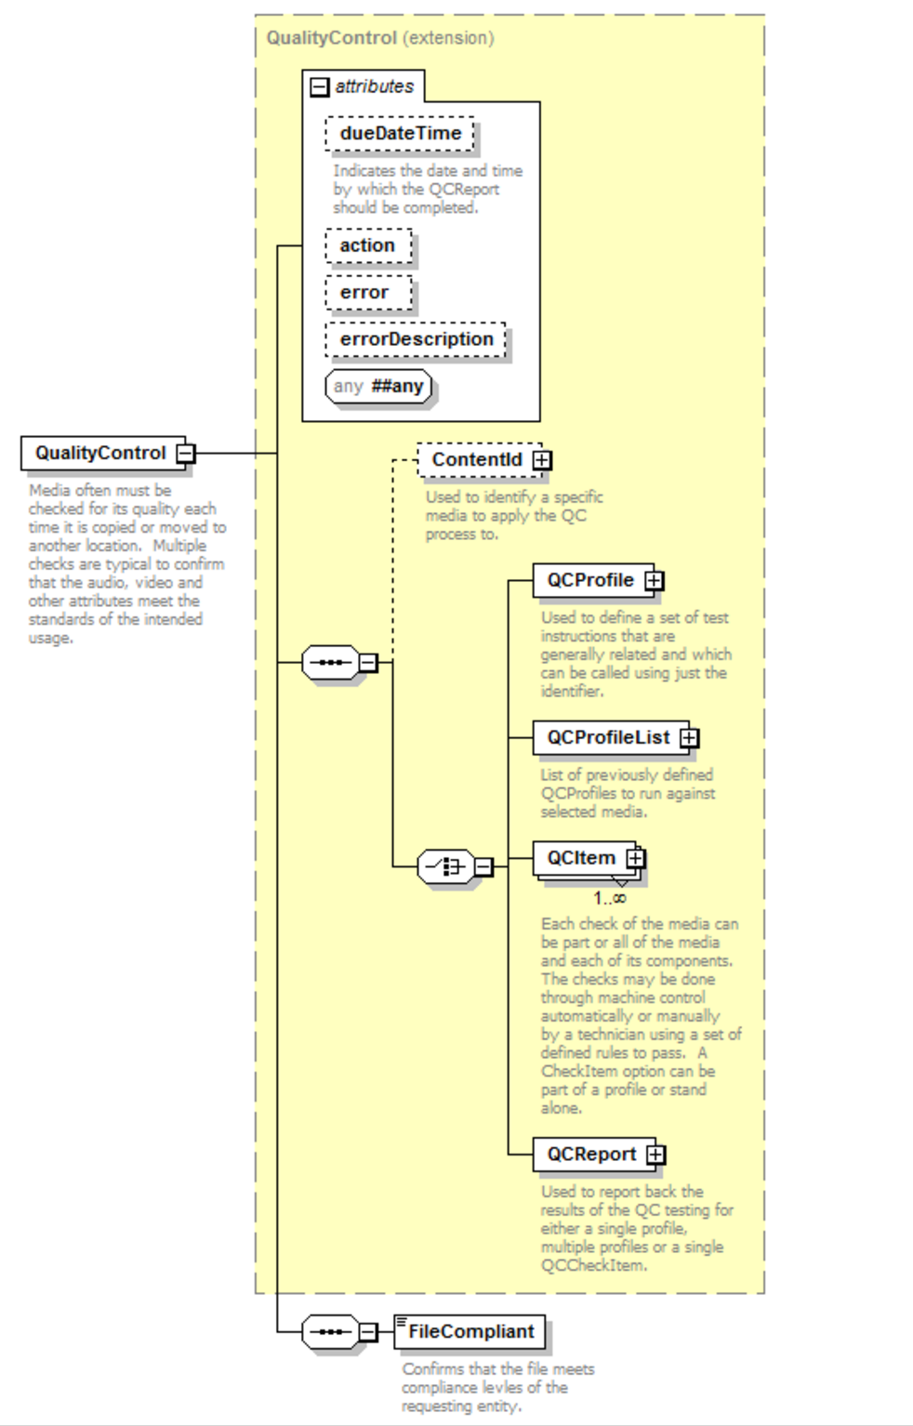
Structure
Simple structure at a high level, but many layers below this

Slide 29
Structure
MXF Descriptive Metadata Goes Here

Slide 30
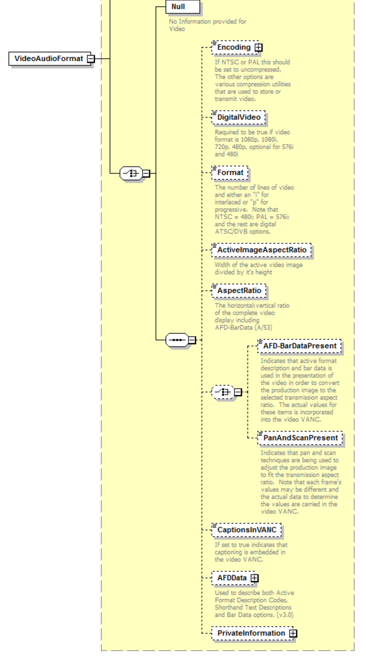
Structure

Slide 31
Structure
Subjective Audio & Video Quality

Slide 32
Later:
Library Master Specification
HD and UHD – both IMF-based (J2K)

Slide 33
Conclusion
Goal is for BXF 5.0 to publish by mid-2017
We will have a machine-readable method of exchanging key content delivery specification details
We will have a standardized means of exchanging QC test details and their results
Excited to see what’s next with Library and Archive Master Specifications

Slide 34
Thank You
Chris Lennon
clennon@medianswers.tv

