Slide 1
HDR in Cinema: Achievable Contrast
Jean-Philippe Jacquemin
Goran Stojmenovik
HPA
February 2017

Slide 2
What we will talk about
Introductory definitions
What’s the actual screen contrast given the projector, auditorium and image content?
What level of black detail we can discern at a certain image brightness?
What does this mean in the ‘bigger picture’ – with realistic content?
Wrapping up

Slide 3
Our previous research
Modelling of achievable contrast and its impact on HDR projection in commercial cinema environments
Tydtgat et al; SMPTE ATC 2015 (talk and paper)
The perceived intra-frame dynamic range in a cinema environment
Maes et al; SMPTE ATC 2016 (talk and paper)

Slide 4
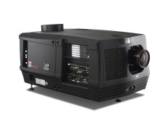
What is projector contrast?
Projector native contrast:
=
illumination of white field
illumination of black field
(with the same lamp power setting and same lens zoom!)
Lw
CR_{nat}=Lw/Lb (:1)
Lb
*Need to measure directly in the projector with a directional lux meter
**Very difficult to measure low black levels accurately: need specific equipment

Slide 5
What about if there is some content in the image?
“Figure of merit” is ANSI contrast = “checkerboard contrast” *
“White” - <Lw>: Average brightness** of white squares
“Black” - <Lb> : Average brightness of black squares
Contrast = “White”/”Black”
CR _{ANSI}=<Lw>/<Lb> (:1)
*As a rule, due to lens and other scattering, ANSI contrast is much lower than native projector contrast
** Measured looking directly in the projector, not off the screen

Slide 6
What we will talk about
Introductory definitions
What’s the actual screen contrast given the projector, auditorium and image content?
What level of black detail we can discern at a certain image brightness?
What does this mean in the ‘bigger picture’ – with realistic content?
Wrapping up

Slide 7
What’s the screen contrast given a projector, auditorium and certain image content?
b. Add scattering (dust, porthole, lens) and diffraction (optics): s%
To calculate CR_{proj}
a. Native, ‘ideal’ projector sequential contrast:
CR_{nat}
c. Reflectivity of the auditorium: ρ% to calculate CR_{theatre}
EXIT
Auditorium Contrast Model, aka “THE MODEL”
(SMPTE ATC 2015, Tydtgat et al)

Slide 8
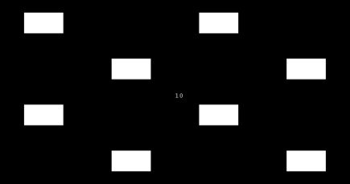
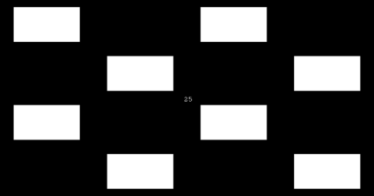
“ANSI-ish” test patterns
Examples of used test patterns with varying white content α, representing an Average Picture Level (APL)
α= 1% 10% 25% 50%
Projector ANSI contrast is determined by optics scatter;
On-screen contrast in addition takes reflections into account.

Slide 9
Mathematical model and approximation
(1-s+sα)CR_{seq}+s(1-α)
CR_{proj}=
(eq.1)
sαCR_{seq}+ (1-sα)
CR_{theatre}= f(CR_{seq},s,ρ,α)
(1+αρ)CR_{proj}+(1-α) ρ
CR_{theatre}=
(eq.2)
αρCR_{proj}+ (1+ρ-αρ)
For (s+ρ)<<1 we obtain:
1
1
+ α(s+ρ)
=
CR_{theatre}
CR_{seq}
Or,
Screen black
=
Projector black
+ α(s+ρ) x
Projector white
(+ Ambient light)

Slide 10
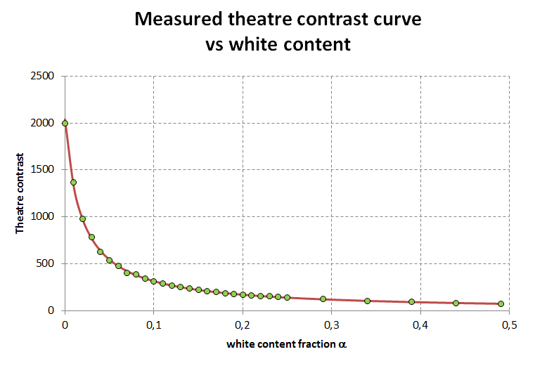
Results: model fit and real-life parameters
Theatre | s | ρ | s+ρ
1 | 0.015 | 0.019 | 0.034
3 | 0.010 | 0.025 | 0.035
4 | 0.005 | 0.011 | 0.016
5 | 0.018 | 0.022 | 0.040
6 | 0.009 | 0.018 | 0.027
7 | 0.008 | 0.021 | 0.029
8 | 0.010 | 0.013 | 0.023
s range: 0.5% - 1.8%
ρ range: 1.1% - 2.5%
s+ρ range: 1.6% - 4.0%
Green circles are actual measurements
The model rocks!
Significant spread in real life parameters.

Slide 11
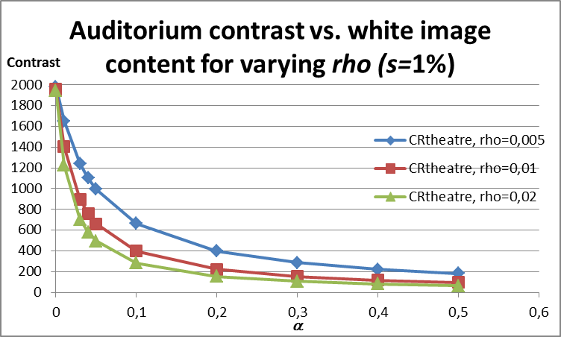
Results: Impact on real-life screen contrast
2000:1 projector, screen contrast drops to 200-400:1 @ 10% APL @ avg auditorium

Slide 12
How does the screen impact on-screen contrast?
Screen type (silver or white) impacts the screen contrast greatly
Typical Silver screens have an TIS (total integrated scatter) of around 50%.
SILVER SCREENS ARE GREY – they absorb 50% of the non-directional illumination.
So the ρ – coefficient implicitly contains the screen ‘reflectivity’ (TIS) as well, next to the room reflection.
WITH THE SAME ROOM REFLECTION, A SILVER SCREEN WILL REDUCE THE ρ BY 50% IN COMPARISON WITH WHITE SCREENS:
SCREEN CONTRAST WILL BE BETTER WITH A SILVER SCREEN!
Screen black
=
Projector black
+ α(s+ρ) x
Projector white

Slide 13
What we will talk about
Introductory definitions
What’s the actual screen contrast given the projector, auditorium and image content?
What level of black detail we can discern at a certain image brightness?
What does this mean in the ‘bigger picture’ – with realistic content?
Wrapping up

Slide 14
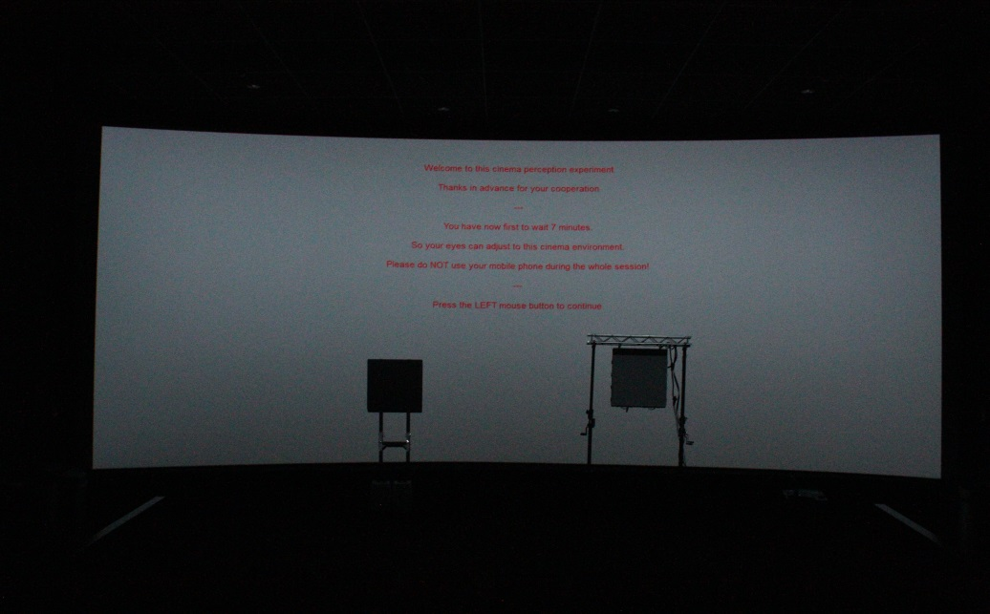
Perception experiment setup
Background grey level projection
0%, 0.5% & 5% (@ 48 cd/m²)
Black plate on the left
ambient + straylight suppression
4000 cd/m² LED wall to the right
0%, 50% & 100%
Left, Right & Full
4000 cd/m² @ full white
36 persons between 18 and 34 years
Black Plate
20x attenuation
LED wall
1.4m
1.4m
12.6m

Slide 15
Perception experiment
Question to test subjects: “How many squares you see”
Attaining the perceptual black threshold, depending on environment and nearby highlights
Influencing parameters on visibility:
Background APL–> black, 0,5% and 5% @ 48 cd/m²
Eye adaptation -> couple of seconds
LED Peak white level -> range 50 Cd/m² ⁻ 4000 Cd/m²
Proximity of peak white level -> test in different positions
9x9 pixels,
Randomly spread

Slide 16
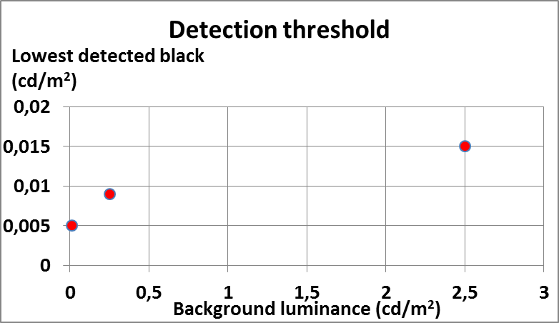
Findings
The HVS can perceive very low levels of black (in ideal environments)
Background adaptation brightness lifts the lowest perceivable level
However:
Auditorium reflectivity and scatter will produce a black level HIGHER than the visible threshold in most cases, even with an infinite projector contrast
Increasing APL levels will also increase reflectivity, further increasing the black level
Background (cd/m²) | Detection threshold (cd/m²)
0,0008 | 0,005
0,25 | 0,009
2,5 | 0,015

Slide 17
What we will talk about
Introductory definitions
What’s the actual screen contrast given the projector, auditorium and image content?
What level of black detail we can discern at a certain image brightness?
What does this mean in the ‘bigger picture’ – with realistic content?
Wrapping up

Slide 18
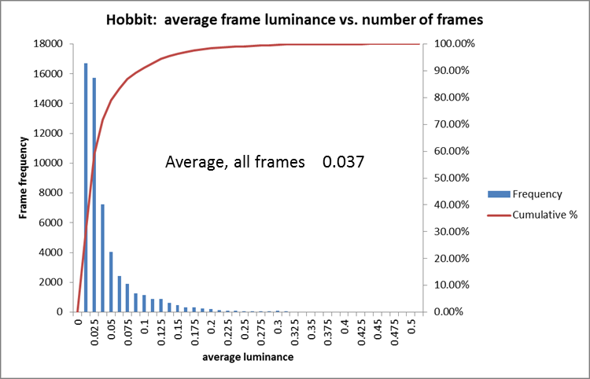
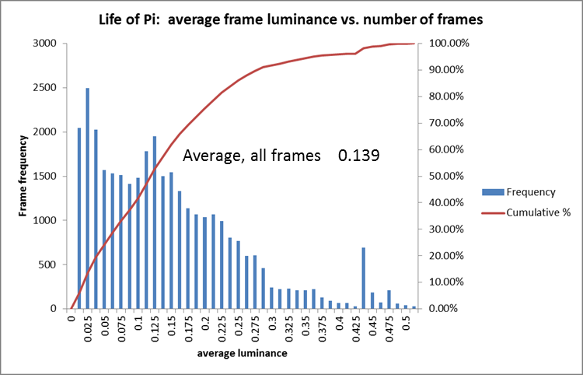
What does this mean for a real movie? -Relevant statistics*
Title | Average luminance | Avg lum. cd/m² (max=48cd/m²)
TinTin | 8.2% | 3.9
Hobbit 1 | 3.7% | 1.8
Shrek 2 | 5.6% | 2.7
Thor | 6.3% | 3.0
Life of Pi | 13.8% | 6.6
KungFu Panda | 5.9% | 2.8
Gulliver's Travels | 11.3% | 5.4
Alice in Wonderland | 6.0% | 2.9
Aggregate Average | 7.6% | 3.6
Standard Deviation | 0.034 | /
*Source: M. Schuck, P Lude RealD paper on SMPTE ATC 2015

Slide 19
Relevant statistics
In an ‘average’ movie (@ 14fL white)
<0.7 cd/m²
(<1.5% APL)
>1.4 cd/m²
(>10% APL)
Darkest 1/10th of the movie
Brightest 1/10th of the movie

Slide 20
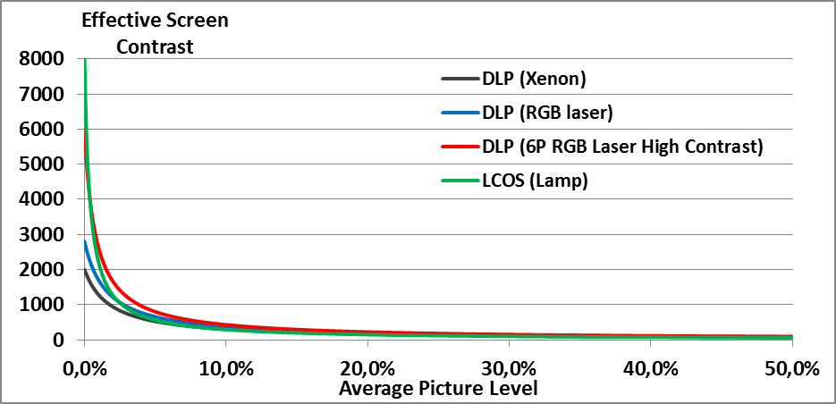
Different projector performance: It’s all in the ANSI!
Contrast reduces significantly from native to ANSI, depending on optics scatter and auditorium reflections (1% reflectance taken here)
1% APL
10% APL
25% APL
50% APL

Slide 21
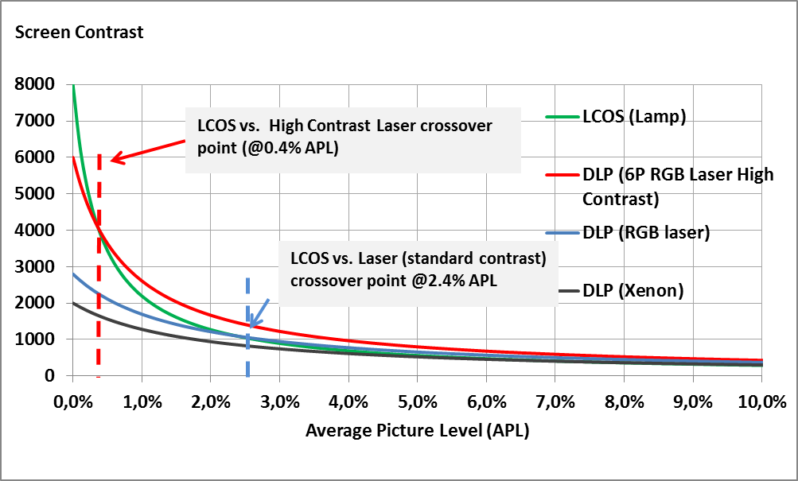
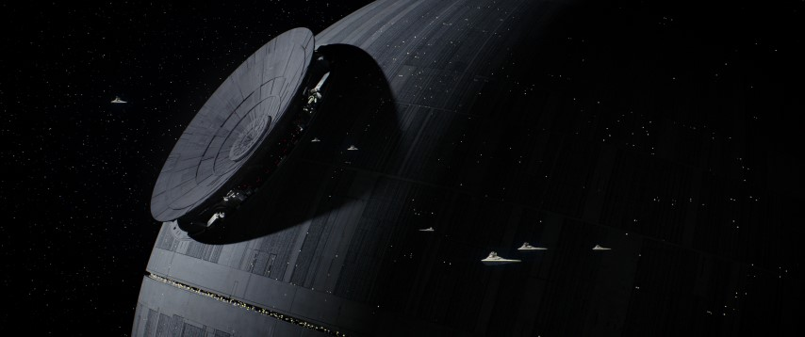
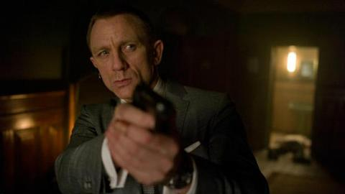
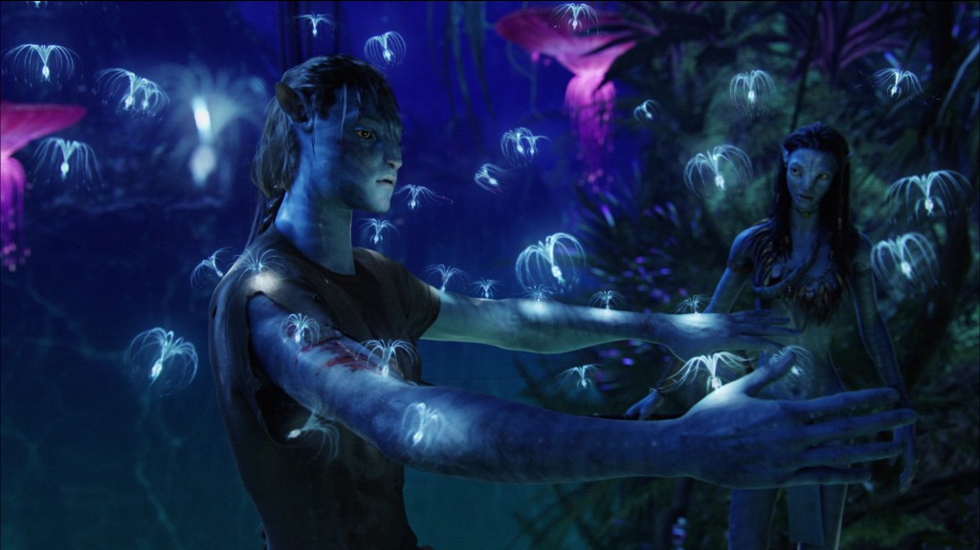
Zoom in on the darker frames
Case with 1% auditorium reflectance – best we measured – and without any audiences!

Slide 22
What we will talk about
Introductory definitions
What’s the actual screen contrast given the projector, auditorium and image content?
What level of black detail we can discern at a certain image brightness?
What does this mean in the ‘bigger picture’ – with realistic content?
Wrapping up

Slide 23
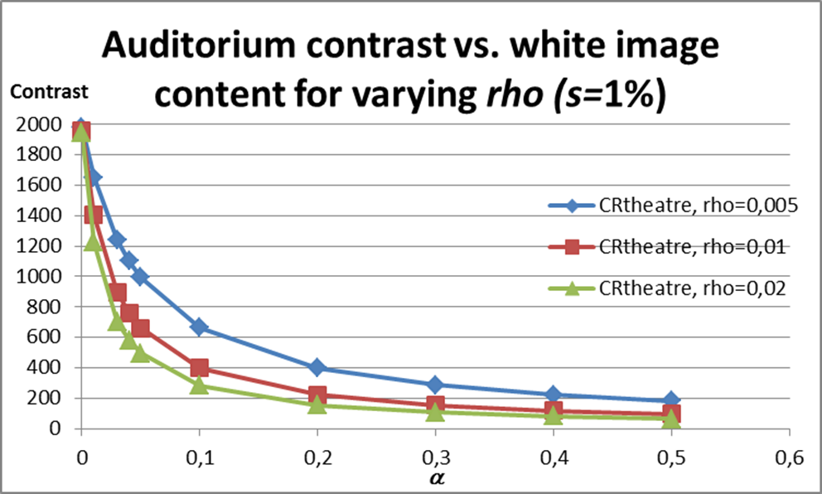
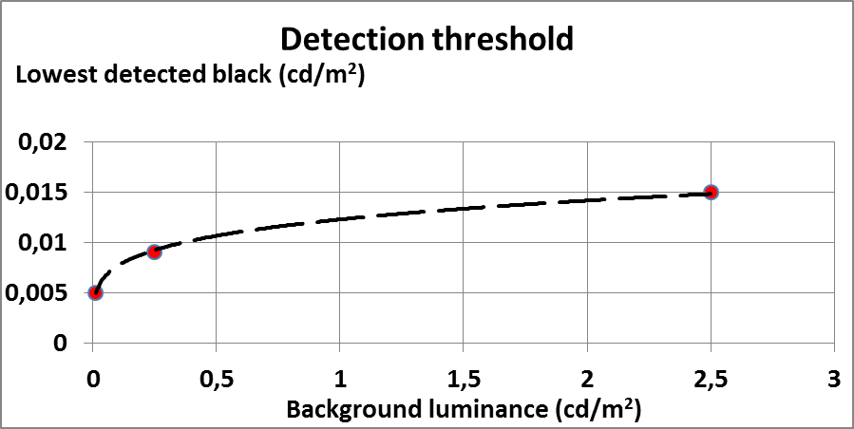
Summary
Real-life scattering and reflectivity can seriously impact screen contrast and black level
HVS black detection threshold is very low, but impacted by image APL
… How does this all add together?

Slide 24
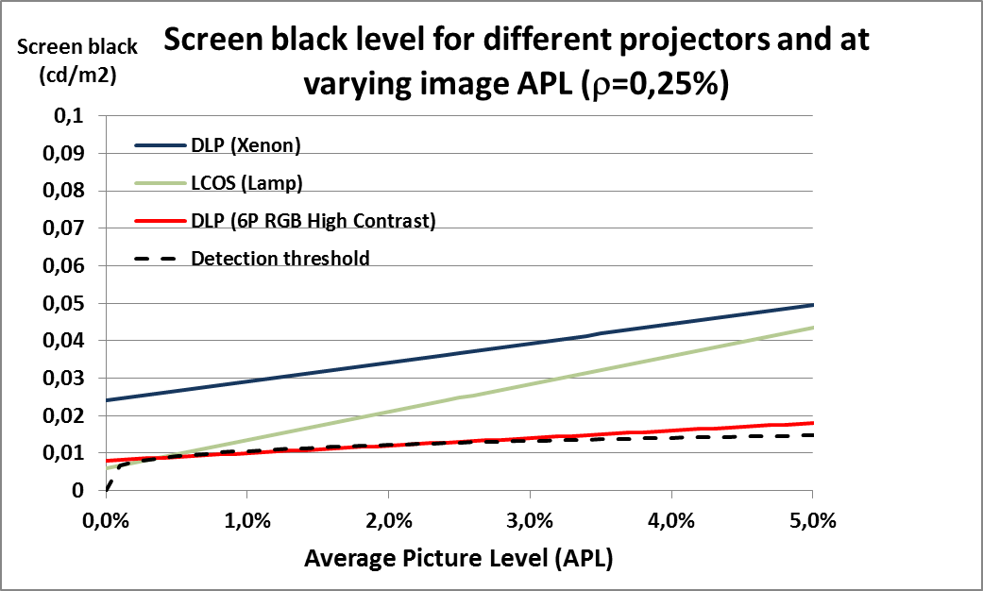
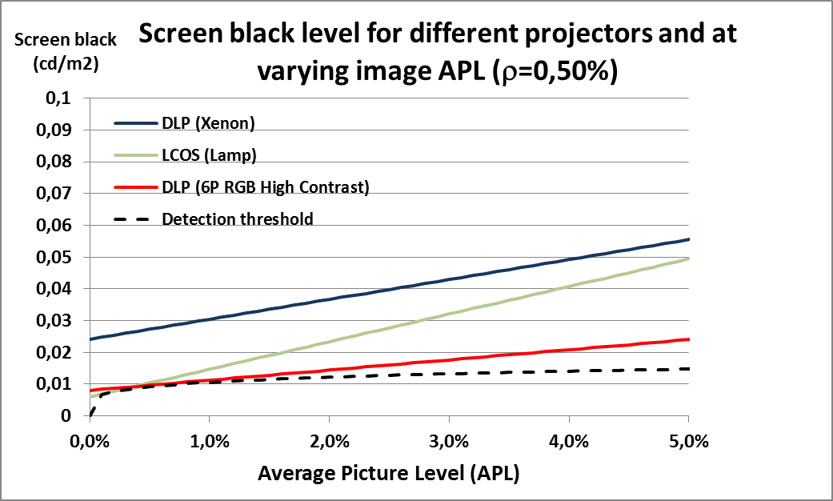
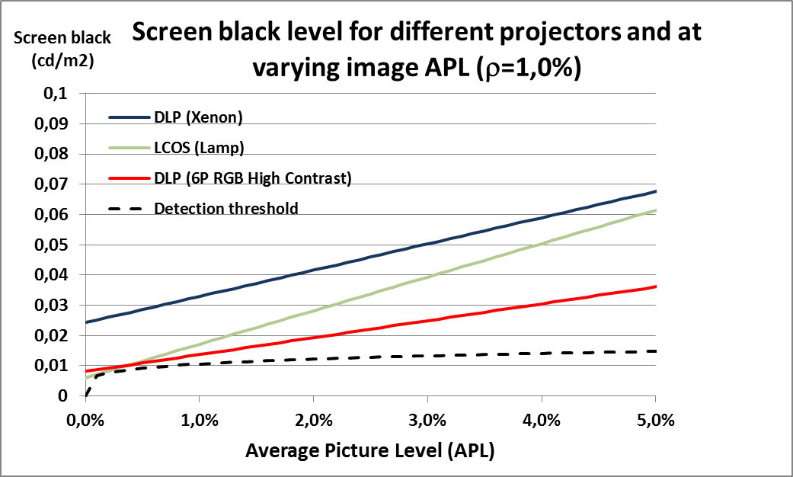
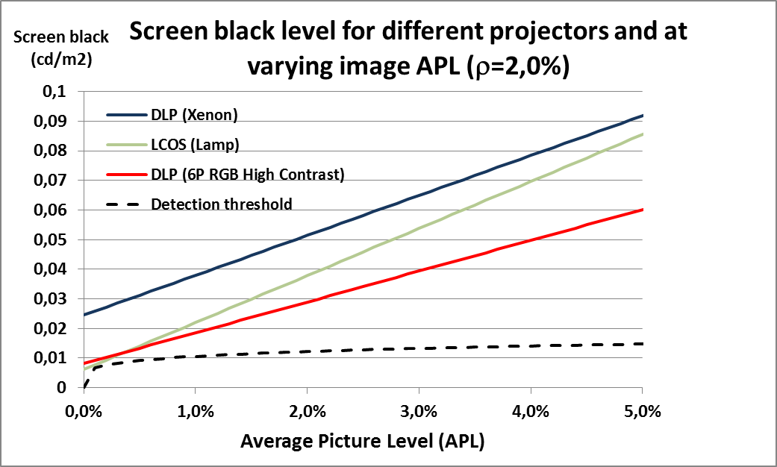
Gluing the pieces together: Screen black level – different projectors and varying image APL

Slide 25
Future work
What is the impact of actual image brightness distribution on perception?
Eye adaptation?
New technologies?

