Slide 2
About the Speaker: Alex LoVerde
CEO & Co-Founder
SyncOnSet Technologies
Winner of 2016 Engineering Emmy

Slide 3
Leveraging cloud for content protection
Notes:
Today I thought it would be interesting to share an example of a content protection measure that requires the cloud. When we think about cloud security, we’re usually focused on the data security elements of the architecture and encryption. An area that we deal in is the protection of content that was previously in physical form.

Slide 4
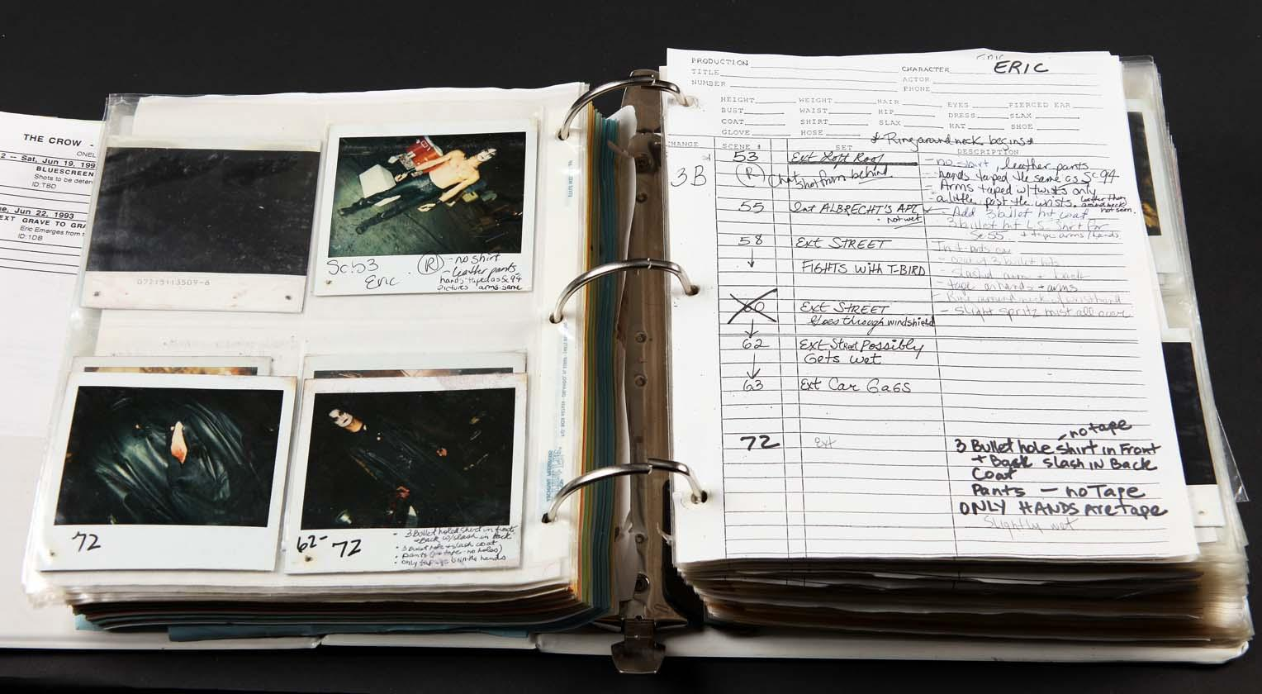
Physical Continuity Binder

Slide 5
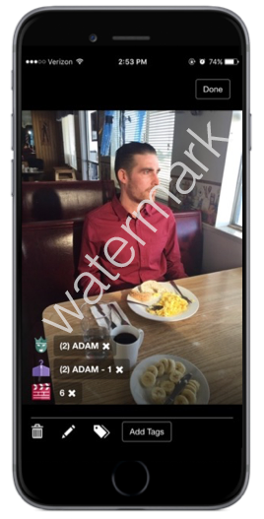
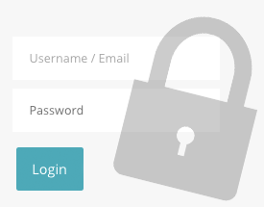
Advancing Content Protection
User Access Controls
Device Limiting
Watermarking

Slide 6
Leveraging Cloud
AWS S3 and Lambda
Example computation for a tentpole feature production:
15,000 individual photos taken
40 users
4 watermarked images per master
=2.4 million watermarked photos

Slide 7
Thank you

