Slide 1
Audio Cloud Collaboration
Gurparkash Saini, Solution Integration Architect

Slide 2
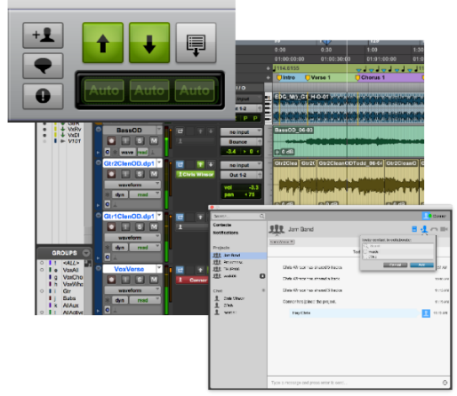
Cloud Collaboration
Collaboration powered by cloud native services built on Amazon (AWS) hosted ‘MediaCentral’ platform
Local Session conversion to/from cloud ‘Project’
Project owner specifies the tracks that are initially shared
Background based transfer services for metadata and media using lossless data compression
Invited collaborators open the cloud project to access shared tracks
Global and track based automatic or manual sync of changes
In-app Instant Chat & Notifications with transaction log
Online/Offline working using local project caches
Plugin management – in-app download from Marketplace
NO MANUAL IMPORT/EXPORT PROCESS – fully integrated in-app experience
Notes:
Last year we introduced Pro Tools Cloud Collaboration.
This allows Pro Tools users to collaborate with other Pro Tools users who are geographically remote. Previously users had to export the session and media files to a drive, transport the drive or file transfer the content to the other user. That user would then copy the files to their storage and import the session. Then the reverse process would have to be done to get the contribution back for the final mix and then add or merge the changes back to the main session. Round-trip this a few times and extend this to multiple collaborators and tracking all the changes and merges become a complex time consuming process. This is a familiar pattern and not just isolated to audio workflows but almost every stage of the production process.
When collaboration is required, the session owner creates a cloud hosted ‘project’ and specifies which tracks to share and invites those within his artist community to participate. Behind the scenes the track media and settings are securely copied to cloud storage, hidden from users. Invited collaborators instantly see the request and on acceptance, the relevant project metadata and files are synced to their local project cache. Other parties see the same information, tracks, mixes and settings. Any adjustments, additions or manipulations are kept in sync and history tracked with granular control of which tracks are updated. Users take advantage of in-built instant messaging to communicate with others in real time.
What nobody sees, or performs, are manual file exports or imports, no 'dropbox' and when needed the user needs to work offline they can. Once they have added their contribution then when next connected they can sync the changes with the cloud hosted project, with automatic notification of changes to other project collaborators.

Slide 3
User Expectations
Ability to use outboard hardware surfaces and interfaces
Real-time processing plugins
Instant feedback of manipulations
No UI lag or delays when adjusting parameters
Maintain full quality audio fidelity
Sample level manipulation
Notes:
Users typically make extensive use of outboard surfaces and interfaces as well as a plethora of real-time processing plugins and virtual instruments.
Users do not want to be bound to a facility, they want to work wherever they want without the constraint of needing to be network connected.
The creative process relies heavily on real-time manipulation, they want to see and hear the effect of making adjustments instantly, in real-time without lag or delay whilst they are recording or mixing.
Typically full quality resolution audio needs to be maintained for professional use with manipulation needed down at the sample level.
Is it possible to use cloud based capability to provide a meaningful contribution to the creative process, maintaining user expectation but opening out the possibility for more flexibility, efficiency and reduce friction?

Slide 4
Cloud Observations & Challenges
Variable Connectivity:
Bandwidth, Latency & Jitter – virtualized network adds additional constraints and latency
Distributed architectures add communication dependencies
Host network and physical infrastructure is shared – VM instances on same physical host have differing needs and may impact available resource resulting in variability
QoS at application level more difficult to implement
Cloud providers may move VM’s to different hosts, datacenters, availability zones or regions to maintain uptime or fault tolerance SLA’s
SLA’s generally do not guarantee performance
Cloud provisioned firewalls & VPN’s add additional variable latency
Congestion/Contention in virtual or physical infrastructure
Notes:
There are several challenges that cloud and virtualized environments exhibit and causes us to think differently when moving applications to the cloud. With on-prem ‘bare metal’ deployments there is total control of the infrastructure, it’s scale out, configuration and management resulting in largely deterministic behaviour allowing the ability to address user expectation.
In a virtualized or cloud environment, especially where there may be the expectation of access over the public internet, there is little visibility as well as ability to control both the virtual or physical environment. This is largely managed by the provider and therefore we need to take this constraint into account when deciding what applications or services can be migrated to the cloud.
As a consequence additional problems around networking and connectivity arise:
Additional bandwidth, latency and jitter between VM’s on the same host, between hosts and other regions as applications exhibit more distributed characteristics.
Underlying physical infrastructure is shared and demands on resource may vary depending on the processing needs of the various VM’s on the same host.
Cloud providers make assurances based on uptime, not generally on performance and in order to meet the SLA may relocate VM’s depending on the options chosen by the consumer when initially provisioning the resource. The result is network performance variability.
The result is that network variability around bandwidth, latency and jitter is more complex to deal with. For some application types this does not present a problem but for certain cases such as Pro Tools this creates difficulties where users have expectations around response and use. This means that a pure ‘lift and shift’ or ‘cloud compatible’ approach would be problematic at this time.
We took the view that the client would have to remain as a local application.
Audio files and data are relatively small compared to video, and therefore transfers across the cloud provider network backbone could be fast. As long as the upload/download could be accommodated, we could exploit content delivery networks CDN’s to localise the media files to the closest endpoints to the end users very quickly. We don’t need constant sync as only changes need to be propagated and many of these are metadata.

Slide 5
Cloud Observations & Challenges
File upload/download times
FTP or other conventional methods exhibit degraded performance over high latency or variable connections
Avid Transport service compresses audio (lossless) and can yield up to 70% payload reduction
Security
Transfers encrypted
No direct access to cloud based storage by users
All access is in-app and authenticated and logged
Scalability
Had to support multiple simultaneous collaboration sessions (+400K Pro Tools downloads, currently +600 simultaneous collaboration sessions and increasing)
Notes:
File transfer mechanisms like FTP degrade dramatically over high latency WAN connections. The Avid Transport Service is used for managing transfers and performs lossless audio data compression yielding file payload reduction of up to 70%.
All transfers are encrypted and no media or project files are directly accessible to collaborators. Interaction is always in-app and users authenticated. Local caches get deleted when the collaborator is removed from a project.
The collaboration services have to be highly scalable, since the service went live middle of last year there has been a steadily increasing number of simultaneous collaboration sessions.

Slide 6
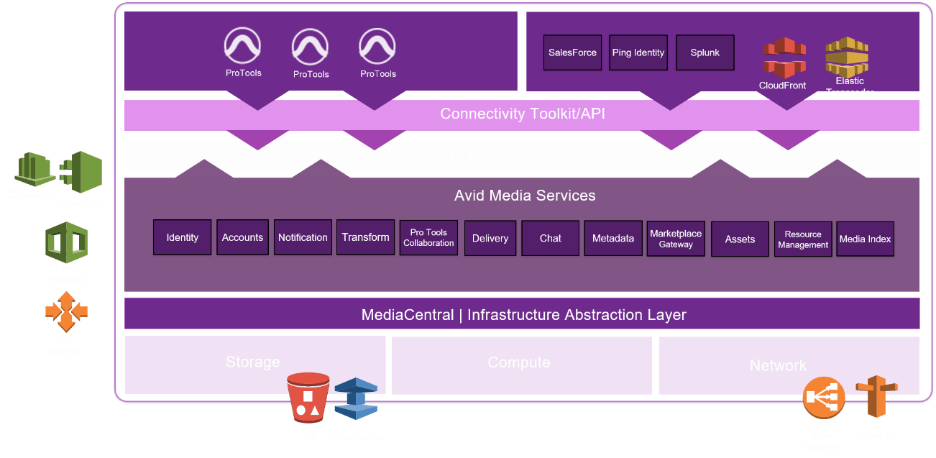
MediaCentral Cloud Platform
Notes:
What we built was the Avid MediaCentral Platform. An integration and services framework built on a layered and microservice based architecture. Into this we deployed the various services to support the ProTools collaboration workflows, but we also needed to accommodate change over time. To date the same platform also supports our Sibelius and Mediacomposer subscription services. The Avid MediaCentral platform is hosted on Amazon (AWS) public cloud.
All external clients and systems ( at the top) access the platform through a single endpoint, load balanced across several upstream servers. Access is authenticated or rejected. If accepted then clients and systems can access REST based (Connectivity Toolkit) API's, but only of those services that they have permissions to use. Important to note is that these REST endpoints do not call the respective platform (Media Services) directly, they are abstracted to calls across the internal MediaCentral Event Bus.
The event bus, built on RabbitMQ provides a high throughput and scalable multi-zone messaging architecture. This abstraction allows service components to be distributed anywhere. The client does not have knowledge or visibility of where the backend services are running which promotes scalability as well as ability for availability and continuity.
The Media Services layer provides two core capabilities. Service packages that expose functionality from backend systems, such as Identity (Ping Identity), Accounts (SalesForce) and various AWS services, as well as ‘business logic’ packages that implement the required workflow choreography such as the Pro Tools collaboration, Metadata, Chat and Transform amongst others.
These service packages can be built by anyone, not just Avid and provides the flexibility to integrate disparate systems, metadata and construct views that make sense for the intended target workflow. In our example managing seamlessly the transfer and management of ProTools projects and mediafiles in the AWS cloud environment.
Lastly the Infrastructure Abstraction Layer provides the means for deploying the Mediacentral platform into different environments and where needed the abstraction of storage and other infrastructure resources.
The MediaCentral platform services are built on a microservice architecture and packaged and deployed as Docker containers, an approach that aligns well with a cloud native service provision.
The MediaCentral platform deployed with the ProTools Collaboration services results in a considerable improvement to the user experience and promotes use of cloud technologies in a positive and visible way to the end user thereby building confidence and opening up the potential for future workflows.

Slide 7



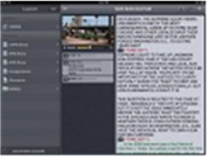
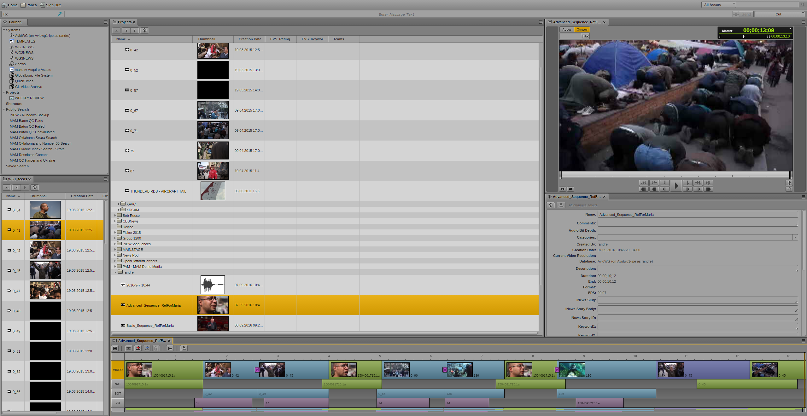
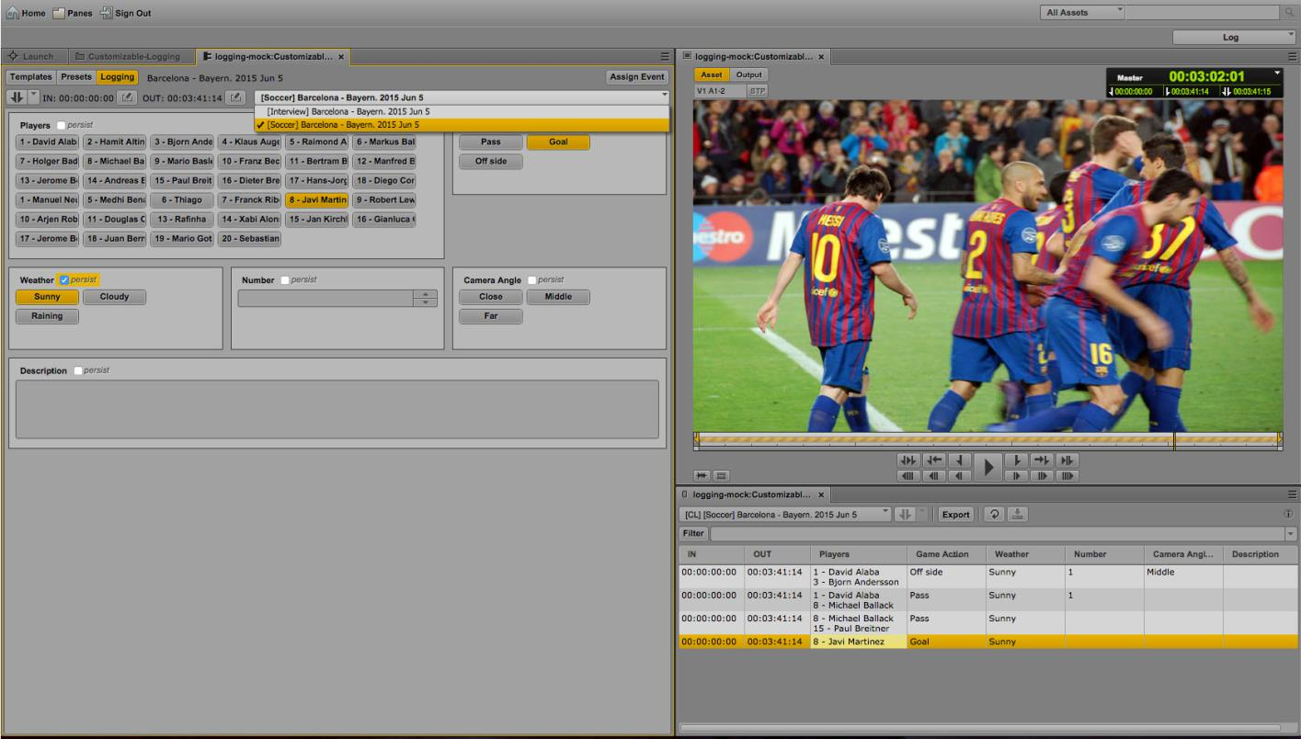
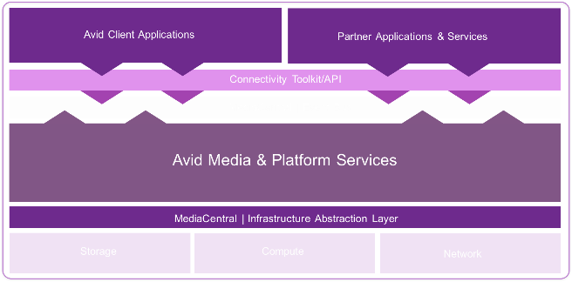


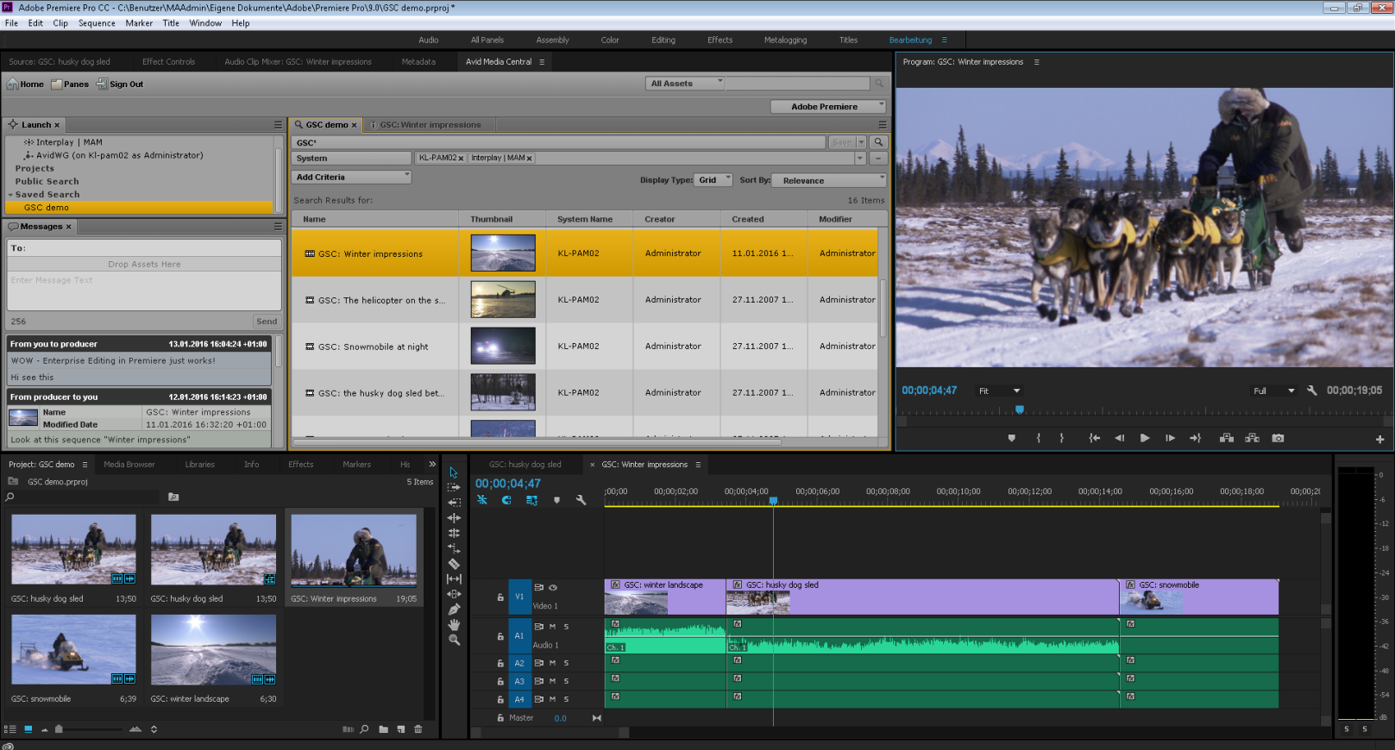
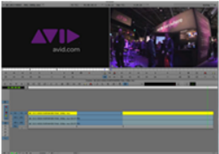





Collaborative Production Ecosystems
Notes:
This is a continuing journey for us. This platform pattern is seen again and again and arises as a consequence of the need for agility, scalability and easy system integration.
The cloud compatible 'lift and shift' approach fails to address workflow silo's and inelegant processes with systems integration remaining problematic. In finance, logistics and retail, use of private or public cloud capabilities and collaboration based on integration has been revolutionary, this is not about replicating the same legacy workflows but improving the end to end experience and creating new ways of working. These trends observed in these other industries are also increasingly seen as desirable in M&E and are essential for building collaborative production ecosystems that help reduce friction and costs across the complete media value chain.
We started off wanting to reduce the pain of collaboration for users of ProTools, a class of application where 'lift and shift' is not a clean fit and proved that by intelligently applying cloud native architectures we can promote cross application, cross vendor and cross site collaboration. We have used the same core integration infrastructure to integrate other cloud based services such as x.news, burst, make.tv into our on-prem production environments based on the same Avid MediaCentral platform, bridging the cloud and on-prem worlds.
Thank you for your time.

Slide 8
Summary
Not all use cases can ‘lift and shift’ to cloud
Use of ‘cloud native’ services can provide valuable new capabilities and promote collaboration
Beware of replicating on-prem silos as cloud based silos
Leverage integration – Platform based paradigm is emergent in cloud space
MediaCentral platform is cloud ready and you may already be using it…
Notes:
In summary:
Not all use cases translate well to cloud in a lift and shift manner
Exploit cloud native services to enhance application functionality and collaboration
Don’t replicate on-prem silo’s – you will still need to integrate them
Use Platform paradigm – it is successful and used by others. It is the pattern that is emergent for cloud based integration.
We are ready, if you use MediaCentral UX, or Mediacomposer remotely using the cloud option, or any of the Avid Mobile apps, then you already are using the MediaCentral platform.
Thank you for your time.

