Slide 1
Protecting Against Ransomware Attacks
Rob Gonsalves, Director of Architecture, Avid

Slide 2
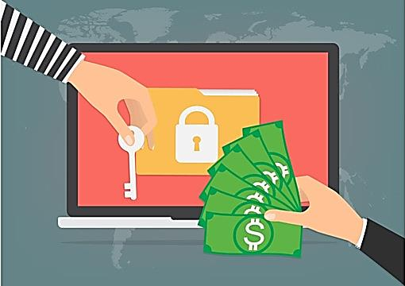
Protecting Against Ransomware Attacks
The Threat of Ransomware
Prevention Measures
Protecting Assets with DR
Q&A
Backup Slides - DR Scripts
Notes:
Ransomware is a type of malicious software designed to block access to digital assets until a sum of money is paid. It is a growing threat for media production companies, as digital media assets are a valued target for hackers.
To protect their media assets and mitigate the risk of these types of attacks, companies can implement a set of security policies, procedures and systems.
Deploying and operating Disaster Recovery systems with specific safeguards against ransomware will help companies retrieve valuable files without having to pay cyber-criminals. Using these techniques, critical business functions can continue in the event of an attack.
There are example scripts in the slide deck that shows how to configure DR systems to protect against ransomware.

Slide 3
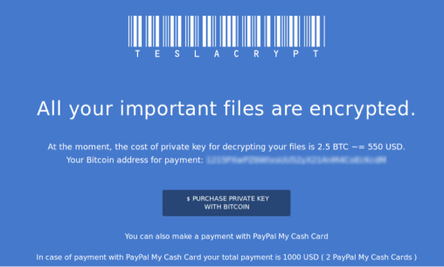
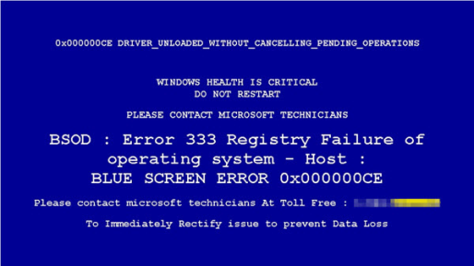
The Threat of Ransomware
Ransomware is a form of malware that encrypts data files and holds the files for ransom.
Malware encrypts files on local drives, shared storage, and other computers ^{[1]}.
Ransom fee is typically $300 to $10,000 in Bitcoin ^{[2]}.
Causes temporary or permanent loss of sensitive or proprietary information.
4,000 ransomware attacks occurred daily in 2016 ^{[3]}.
This is a 4 times increase from 2015 ^{[3]}.
[1] Incidents of Ransomware on the Rise, FBI
[2] The Evolution of Ransomware, Symantec
[3] How to Protect Your Networks from Ransomware, US DOJ Cybersecurity Unit
Notes:
Users and organizations are generally not aware they have been infected until they can no longer access their data or until they begin to see computer messages advising them of the attack and demands for a ransom payment in exchange for a decryption key.

Slide 4

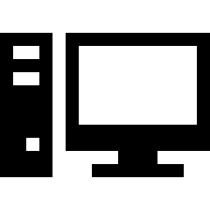







Initial Ransomware Attack
Intranet Server
Site with Malware
Cyber Criminal
Users
Manager
Shared Storage
Firewall
Notes:
The cyber-criminal sends the private key, which is used to unlock the encrypted documents.

Slide 5

Initial Ransomware Attack
Intranet Server
Site with Malware
Cyber Criminal
Users
Manager
Shared Storage
Firewall
Notes:
The following sequence of illustrations shows what happens in a typical ransomware attack.
The initial attack often comes when a user inadvertently downloads and installs malware from a website. After installation, the ransomware quietly searches for and encrypts files. Its goal is to stay below the radar until it can find and encrypt all of the files that could be of value to the user. By the time the company is presented with the malware’s message with the ransom demand, the damage has already been done [2].

Slide 6



Cleaning up the Systems
Intranet Server
Site with Malware
Cyber Criminal
Users
Manager
Shared Storage
Firewall
Notes:
The malware can be removed from the systems, but if enough important files have been encrypted, the company may decide to pay the ransom. If so, money is deposited in the cyber-criminal’s Bitcoin account.

Slide 7

Making the Payment
Intranet Server
Site with Malware
Cyber Criminal
Users
Manager
Cash in Bitcoin
Shared Storage
Firewall
Notes:
The malware can be removed from the systems, but if enough important files have been encrypted, the company may decide to pay the ransom. If so, money is deposited in the cyber-criminal’s Bitcoin account.

Slide 8

Receiving the Key
Intranet Server
Site with Malware
Cyber Criminal
Users
Manager
Key for Decryption
Shared Storage
Firewall
Notes:
The cyber-criminal sends the private key, which is used to unlock the encrypted documents.

Slide 9

Decrypting the Files
Intranet Server
Site with Malware
Cyber Criminal
Users
Manager
Shared Storage
Firewall
Notes:
The cyber-criminal sends the private key, which is used to unlock the encrypted documents.

Slide 10
Ransomware Families
These are the most common ransomware families that were active in 2016. ^{[4]}
The top three families, Tescrypt, Crowti, and Fakebsod account for 74% of all attacks last year.
[4] Microsoft, “Ransomware Facts”
Notes:
Cyber-criminals use variants of base malware software to perpetrate their crime. These base packages are grouped into families of ransomware.
The chart shows the most common ransomware families that were active in 2016 [4].
You can see that the top three families, Tescrypt, Crowti, and Fakebsod account for 77% of all attacks last year. More information about the specifics of these ransomware families is available at Microsoft’s Malware Prevention Center.

Slide 11
Target Files
Ransomware doesn’t try to encrypt every file on the infected system.
It looks for specific file types to encrypt that are likely to contain high value content.
Over 300 file extensions are targeted ^{[3]}.
This includes 17 media file types.
[3] Microsoft, “Ransomware Facts”
File Usage | File Extensions
Archive | .7z .gz .tar .zip
Development | .asp .bat .c .class .cpp .cs .h .hpp .jar .java .js .m .sql .vb .xml
General Use | .doc .docx .pdf .ppt .pptx .txt .xls .xlsx
Media Assets | .jpeg .jpg .m4a .mov .mp3 .mp4 .mpeg .mpg .png .psd .raw .svg .tif .tiff .wav .wma .wmv
Notes:
The ransomware software doesn’t try to encrypt every file on the infected system. It looks for specific file types to encrypt that are likely to contain high value content.
Over 300 file extensions are targeted [4]. The table shows some of the common file extensions grouped by areas of usage.

Slide 12

Example Threat Behavior - Tescrypt
Application Data
Roaming\qubmvec.exe
Documents
BusinessPlan.docx
BusinessPlan.docx.crypted
OpeningMusic.wav
OpeningMusic.wav.crypted
NewAnimation.mov
NewAnimation.mov.crypted
Windows OS
Java
Flash
Acrobat
Silverlight
Browser
Etc.
Intranet Server
Site with Tescrypt
User
Registry
HKCU\...\Run
cmd.exe /c start
Cyber Criminal
Firewall
Client System
Notes:
Exploit
Exploits vulnerabilities in Java, Adobe Flash Player, Adobe Acrobat Reader, Microsoft Silverlight, and Internet Explorer.
Installation
Installed in the Application Data, Documents, or root folder.
It uses a random name, i.e. apsjnlkvgvvi.exe
It uses registry key to launch, i.e. Software\Microsoft\Windows\CurrentVersion\Run
Encryption
It searches for the target files, encrypts them, and renames the extension, i.e. .crypted
For more info see [3] : https://www.microsoft.com/security/portal/threat/encyclopedia/Entry.aspx?Name=Win32/Tescrypt

Slide 13

Prevention Measures
User Training
Patch Management
File Permissions
Endpoint Security
Shadow Copies
STIGs
Notes:
There are several strategies that companies can use to mitigate the threat of ransomware. The first and foremost is prevention – don’t allow malware to infect the systems in the first place.
User Training - Most ransomware spreads through phishing and scam emails. User training plays an important factor in preventing security breaches [5]. Employees need to know the policies and practices they are expected to follow regarding Internet safety, and what to do if a breach occurs [6].
Patch Management - One of the most common methods for ransomware is to exploit security flaws in commonly used software, like web browsers. The best defense against malware infections is to ensure that your software and operating system are up to date with security patches. The use of automatic updates ensures that you are using the latest versions of software, which often contain security fixes [2].
File Permissions - Another step to mitigate ransomware is to manage the use of privileged accounts. No users should be assigned administrative access unless absolutely needed, and only use administrator accounts when necessary. Configure access controls, including file, directory, and network share permissions appropriately. If users only need read-specific information, they don’t need write-access to those files or directories [1].
Endpoint Security Software - Endpoint security systems are a good defense against ransomware. Ensure antivirus and anti-malware solutions are set to automatically update and conduct regular scans [1]. Consider using a managed endpoint security solution that allows IT to centralize security for the entire organization and take full control of these measures. Doing so will drastically decrease the threats from computer viruses and malware, including ransomware [7].
Shadow Copies - Client computers can be set up to make recovery points at regular intervals. These backups are called shadow copies. If this service is enabled and if the ransomware does not interfere with this feature, it may be possible to recover some files using this method [2]. However, newer families of ransomware try to delete all the shadow copies, so this may not help in all cases [5].
STIGs - A Security Technical Implementation Guide (STIG) is a cybersecurity methodology for standardizing security protocols within networks, servers, computers, and logical designs that enhance overall security. These guides, when implemented, enhance security for software, hardware, physical and logical architectures to further reduce vulnerabilities [8]. The US National Institute of Standards and Technology keeps a database of security checklists for various operating systems and applications [9].

Slide 14

Protecting Assets with DR Systems
Develop a Disaster Recovery strategy.
Use automated tools to make backups of valuable files.
Configure the DR system to protect against ransomware.
If you get hit by an attack, you can restore the files from the backup copy.
Sample DR scripts are available in the backup slides in this deck.
Notes:
A key component to prepare for a ransomware attack is developing a robust backup strategy and making regular backups. In the event that your system is attacked and files are encrypted, your only viable option is to restore the backup. Your other options are to pay the ransom or lose the data [7].
Making backups is always a good idea, even without the threat of ransomware. Backups are an essential part of disaster recovery (DR) plans, which all businesses should have [2]. To learn about deploying a DR system for media production companies, see the technical brief, “Avid MediaCentral Platform Disaster Recovery Systems” [10].
DR systems can be configured to address the specific threats of ransomware, using techniques like deferred deletes, threshold triggering, and multiple copy backups. These techniques are described in general in the following sections. You can find example scripts that show an implementation of these techniques in the backup slides

Slide 15
Basic Disaster Recovery
Backup
Primary
Mon
Tue
Wed
Thu
Fri
Notes:
A common DR practice is to have two systems running, a primary system where daily work is done, and a backup system which is used to keep a safe copy of the work. A script runs nightly, making a mirror copy of the files on the primary system to the backup system.
The illustration shows how the basic system works. In this example, a green file is created on Monday, a blue file is created on Tuesday, and a purple file is created on Wednesday. A ransomware attack hits on Wednesday, encrypting the green file, and spreads to encrypt all remaining files on Thursday.
Without being tuned to handle ransomware attacks, the system blindly copies new and changed files every night. By Friday, all files on both the primary and backup system are encrypted.

Slide 16
Deferred Deletes
Backup
Primary
Mon
Tue
Wed
Thu
Fri
Notes:
Because the ransomware renames files after encryption, each affected file will look like a deleted file replaced with a new file to the DR script. For example, if a file named BusinessPlan.docx is encrypted by ransomware and renamed to BusinessPlan.docx.crypted, the script will think that the original BusinessPlan.docx file was deleted and BusinessPlan.docx.crypted is a new file.
One way to prevent the spread of the ransomware attack is to use scripts that defer deletion of files on the backup system by some period of time, say seven days. This will allow for time to recover files after an attack.
With deferred deletes, the DR system will keep a copy of both the original file and the encrypted file on the backup system. These files will remain on the backup system until the next scheduled run of the script that deletes files.

Slide 17

Threshold Triggering
Backup
Primary
Mon
Tue
Wed
Thu
Fri
Notes:
With ransomware attacks, there might not be a demand for payment immediately. So it is important that the activity be noticed quickly. DR scripts can be configured to report storage anomalies, which can help identify that an attack has occurred and is underway [11].
To achieve this, the DR script can be configured to have thresholds for new and deleted files for a workday. If a threshold is breached, the DR script does not run, protecting the assets. The script can be configured to send an alert to system administrators, as part of an early detection system.
In this example, you can see that the initial ransomware attack on Wednesday goes undetected because it only encrypted one file. But when all the files are encrypted on Thursday, the backup script does not run, and a warning email goes out to the system administrator.

Slide 18
Multiple Copy Backups
Mon
Tue
Wed
Thu
Primary
Mon
Tue
Wed
Thu
Fri
Notes:
A more robust way to perform backups is to create multiple, independent copies of files. If you have enough storage capacity on the backup system, you can configure the DR script to copy files to multiple backup folders. For example, you could have folders named Mon, Tue, Wed, etc. on the backup server. The scripts would then choose which folder to use on the backup system based on the day of the week.
In the example, when the ransomware attack hits on Wednesday and Thursday, all files can be safely retrieved because of the multiple daily backups.
Note that the three DR techniques are not mutually exclusive. It is possible to combine two or more, if needed. For example threshold triggering could be added to the multiple copy backup system. If on any given day the number of files to be copied or deleted on the backup server exceeds the threshold, the DR script would be suspended and an email would be sent to the system administrator.

Slide 19

Conclusions
Ransomware is a growing threat to business.
Measures reduces the risk of attacks:
  User Training
  Patch Management
  File Permissions
  Endpoint Security Software
  Shadow Copies
  STIGs
DR systems can to reduce risk of ransomware:
  Various configurations for prevention
  Means to recover data in the event of an attack

Slide 20
References
Incidents of Ransomware on the Rise, FBI, April 2016
The Evolution of Ransomware, Symantec August 2015
Protect Your Networks from Ransomware, DOJ Cybersecurity Unit, June 2016
Ransomware Facts, Microsoft, January 2017
Survival Guide for Ransomware Attacks, SANS Information Security Training, May 2016
Train Your Employees, National Cyber Security Alliance, September 2012
Protect and Recover Your Business from Ransomware, PC Magazine, June 2016
Security Technical Implementation Guide, Wikipedia, June 2016
Security Configuration Checklists Repository, NIST, Jan 2017
Avid MediaCentral Platform Disaster Recovery Systems, Avid, October 2015
Best Practices to Protect Against Ransomware, Gartner, June 2016
Notes:
There are a lot of good resources available to help protect against ransomware.

Slide 21
Q&A

Slide 22
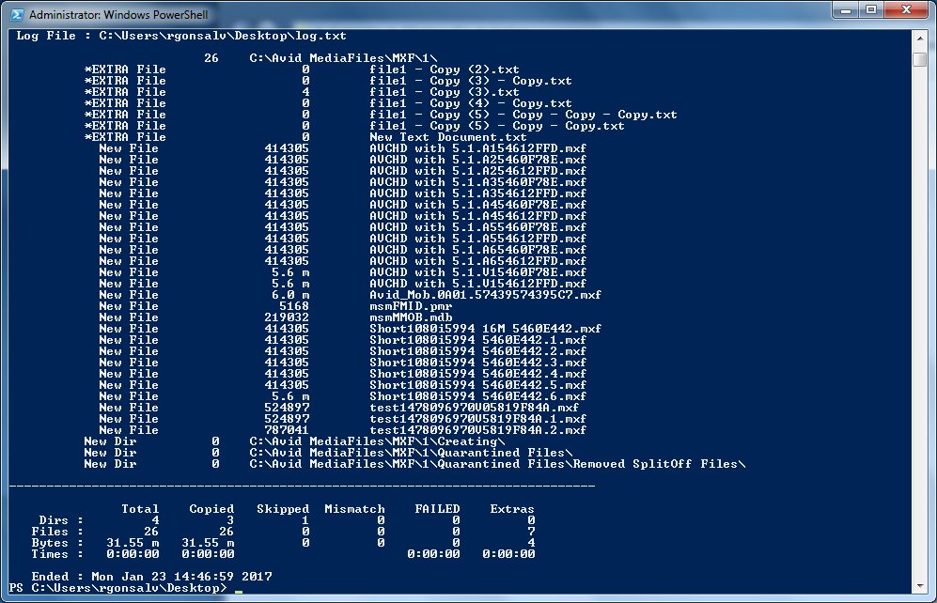
Disaster Recovery Scripts
The scripts show how to implement the DR techniques described in this talk.
They are Windows batch and PowerShell scripts.
The scripts can be adapted to run on Linux or Mac using rsync instead of robocopy.
The following scripts are provided without warranty of any kind. Use at your own risk. Avid and the author are not responsible for lost data or content, or any other loss or damages.
Test the scripts thoroughly on a noncritical staging system before deploying them to your production system.

Slide 23
Script for Basic Disaster Recovery
Basic DR script that uses robocopy:
  @rem mirror the contents from the primary to backup
  robocopy \\primary\media \\backup\media /purge /e
It Mirrors the contents from the media folder on the primary system to the backup system.
The /purge option causes robocopy to delete files that are on the backup server but are not present on the primary server
The /e option is to handle all files in nested subfolders.

Slide 24
Scripts for Deferred Deletes
Robocopy without the /purge option will not delete files. Run this daily:
  @rem Copy the contents from primary to backup
  robocopy \\primary\media \\backup\media /e
With /purge /nocopy, this script will only do deletes. Run this weekly:
  @rem Delete the contents on the backup server
  @rem that do not exist on the primary server
  robocopy \\primary\media \\backup\media /e /purge /nocopy

Slide 25
Script for Threshold Triggering
Written in Windows PowerShell
Defines percentage thresholds:
  Files to be copied
  Files to be deleted
The script runs robocopy in a “preflight mode” first.
If the number of files is under the threshold, then robocopy is run a second time to do the copy / delete.
If not, an email is sent to the system administrator and the backup is suspended.
#define the paths for primary and backup
$primary = "\\primary\media"
$backup = "\\backup\media"
#set the thresholds
$copyThresholdPct = 30.0
$deleteThresholdPct = 15.0
#run the preflight with robocopy and log the output
robocopy $primary $backup /l /e /purge /njh /log:log.txt
#read log.txt to get the file count stats
$fileCounts = Get-Content log.txt | Select-String -pattern "Files :"
$counts = $fileCounts.Line.Split(" ", [System.StringSplitOptions]::RemoveEmptyEntries)
$total=$counts[2]
$numCopy=$counts[3]
$numDelete=$counts[7]
#if we have some files to copy or delete
if ($total -gt 0 -and ($numCopy -gt 0 -or $numDelete -gt 0))
{
#calculate the percentages
$PctnumCopy = 100 * $numCopy / $total
$PctnumDelete = 100 * $numDelete / $total
#if either threshold is exceeded, send an email
if ($PctnumCopy -gt $copyThresholdPct -or $PctnumDelete -gt $deleteThresholdPct)
{
$body = "Total: {0}, to copy: {1}, to delete: {2}" -f $total, $numCopy, $numDelete
Send-MailMessage -From "<script@foo.com>" -To "<sysadmin@foo.com>" -Subject `
"Warning - Copy Script Failed" -Body $body -SmtpServer "smtp.foo.com"
}
else
{
#run the robocopy to copy/delete the files
robocopy $primary $backup /e /purge
}
}

Slide 26
Script for Multiple Copy Backup
Script for making multiple copy backups uses folders named for the days of the week:
  @rem Mirror the contents from the primary to the backup
  @rem server, using folders for each day rem of the week
  set day=%DATE:~0,3%
  robocopy \\primary\media \\backup\%day%\media /e /purge
The files will be copied to folders named Sun, Mon, Tue, etc. on the backup system.

