Slide 1
Bundle Formats for Project Exchange
Stephen Wilson
Avid Architecture Group
20th Feb, 2017

Slide 2
Changing face of the media factory
Asset management and metadata manage the lifecycle of media creation
Traditional
Value Chain
Pre-Production
Production
Post-Production
Distribution
and Delivery
Planning and workflow help define and manage the interaction across the Value Chain
Collaboration increasingly occurs across communities of creatives or studios in Production and Post-Production
Multi-platform, integrated delivery and personalization creates complexity and pushes requirements upstream
Evolving
Value Chain
Smart-media creation, digitalization and collaboration
Personalized delivery and experience management
Source: Avid, PwC
Notes:
Tighter iteration
Versions, revisions and collaboration.

Slide 3
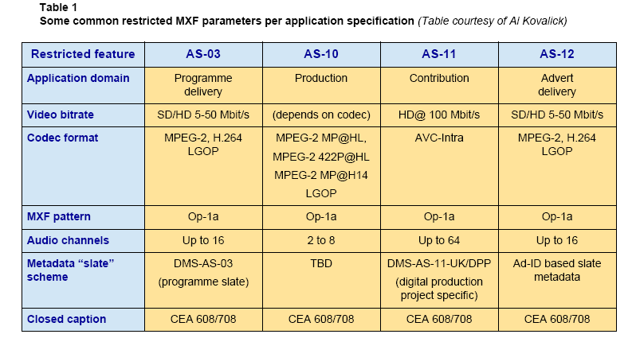
Package Formats
Notes:
Key differences between formats
Package format (single file containers) v bundle format AS-02, IMF
AS - AMWA Standard
Quick Time (Mov) – add logo

Slide 4
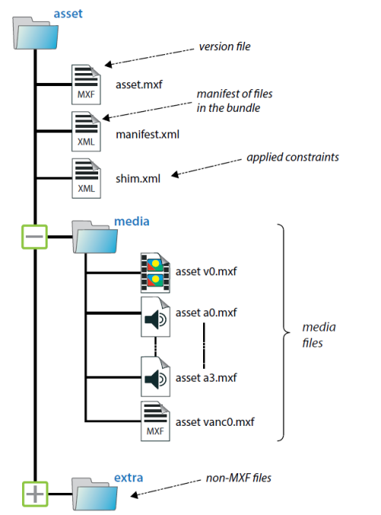
Bundle formats - AS-02
Multi-versioned program deliveries
Uses MXF - single file for each video, audio and data element.
Allows automated workflows
Extras folders – bag of goodies!
Sequences
Notes:
Goodies story

Slide 5
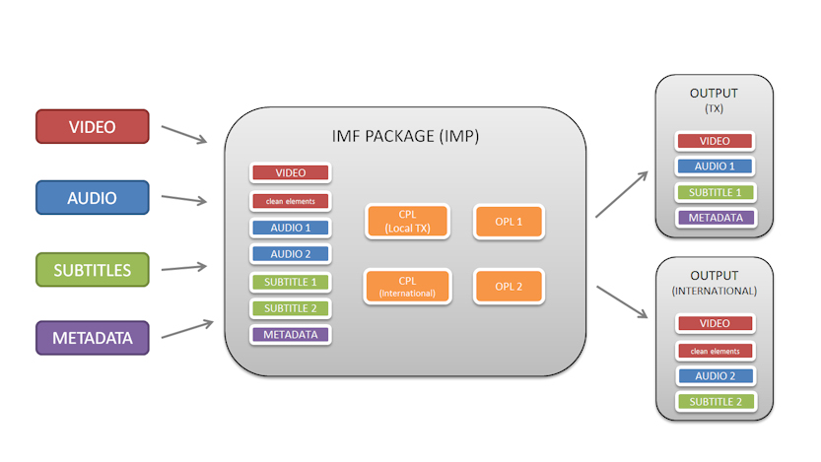
Bundle Format - Interoperable Master Format (IMF)
EBU - https://tech.ebu.ch/imf
Notes:
Steal an IMF pic
AS-02 similar timeline to CPL, has timeline description based on OP-2B or OP-3B format
IMF
AS-02 volume video

Slide 6
Bundle Based Collaborations
Asset maps and relationships as per IMF
All media assets in a post production
  Audio, Video, Graphics…
Options for re-purposing and exchanging compositions
  Flattened – “Guide Tracks”, “Master output”, Final delivery versions
  Shallow for repurposing – CPL level
  Deep for remixing original content and original compositions
Versioning, re-visioning and collaborations
Post-production media in native formats
Bundle
Mix-down (flat)
CPL (shallow)
Complex compositional (deep)
Media assets (source)
Notes:
Audio work mostly broadcast wav
IMF based broadcast masters
Interoperarable masters – flattened
Production Masters – includes all media, sessions
Formalize the extras folder
Keep the rich relation ships
Derive the IMF from the Production master
Versions v revisions

Slide 7
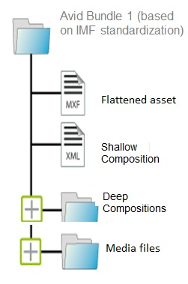
Workflows
Publish
Collaborate
Cloud Storage
Distribution
MAM Archive
Bundle
Proxy Player
Distribution Format
Publishing Formats
Preview, Play
Theatrical (DCP)
Web Editor
YouTube
Cut-down, Replace
Broadcast (AS-11)
Native Editors
iTunes
Remix, Re-edit
Notes:
Tying everything together – the grand vision
From bundle format from AS-02 – can add to the bundle with out completely moving everything
PT production using broadcast wave
Object storage
Graph database for revisions, relationships and project structure (hierarchy)
Object storage and graph data based v file storage
User collaboration
Move graph to cloud
Send to Sara and Tim C

