Slide 1
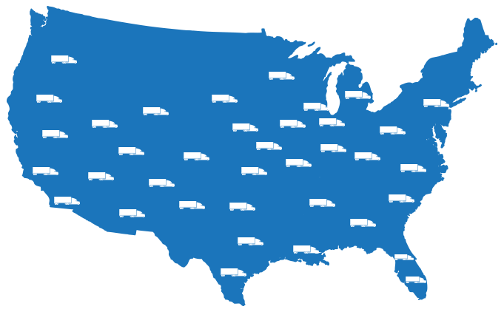
New to HPA
Who is MTVG?
4,000 Live Events Per Year
200+ UHD/4K HDR Live Productions
37 Mobile Units Throughout the U.S.
Advanced Manufacturing Facility

Slide 2
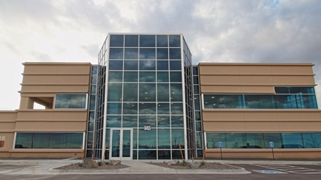
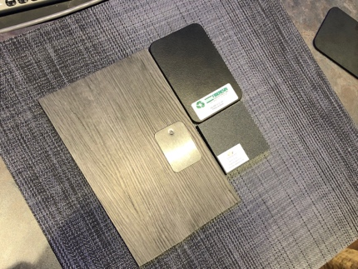
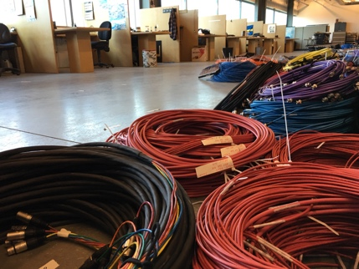
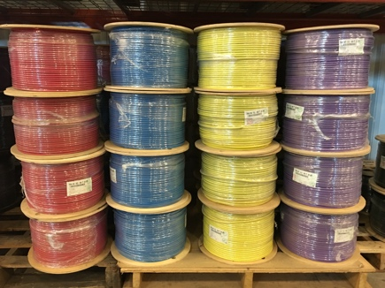
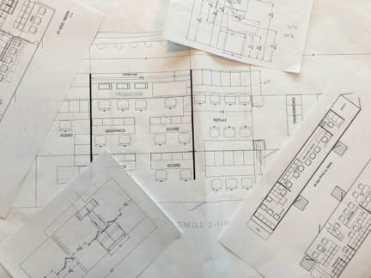
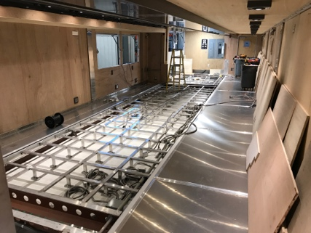
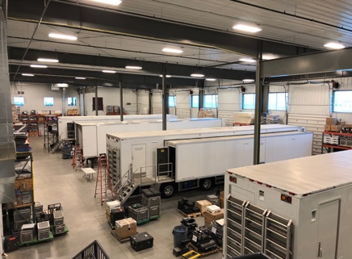
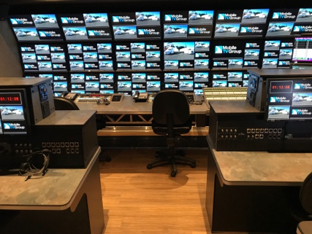
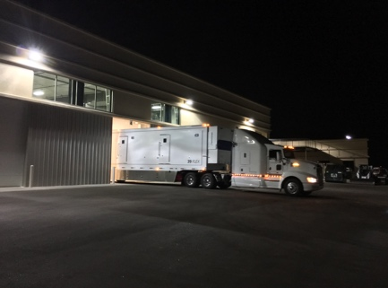
Currently Building First Fully IP Mobile Unit
MTVG Builds Everything From Start to Finish.
4
3
2
1 Start
5
6
7
8 Finish

Slide 3
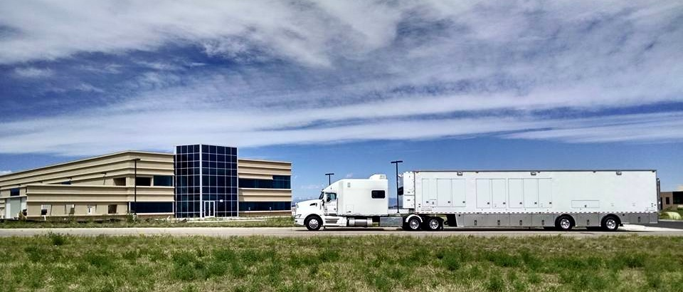
Built & Integrated In One Place. Supported Nationwide
MTVG’s A/V Manufacturing Center & Headquarters

Slide 4
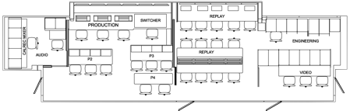
The Process
Inside our Factory & Headquarters
Clean
Room
(Fiber Termination)
Engineer
Support &
Service
Wire Termination
Design
IT
Wood
Work
Integration
Maintenance Bays
Metal
Work

Slide 5
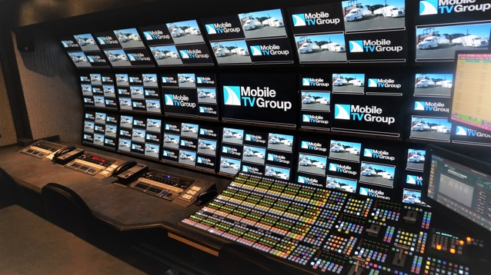
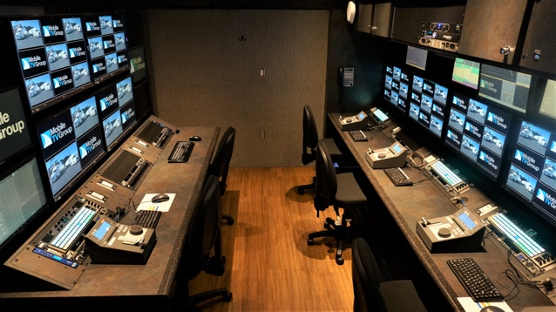
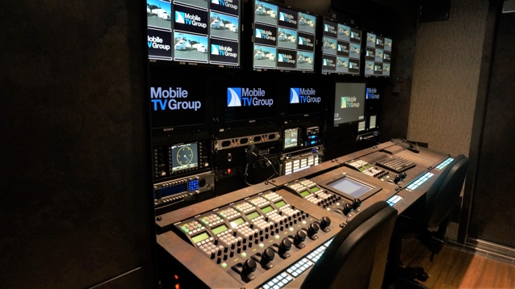
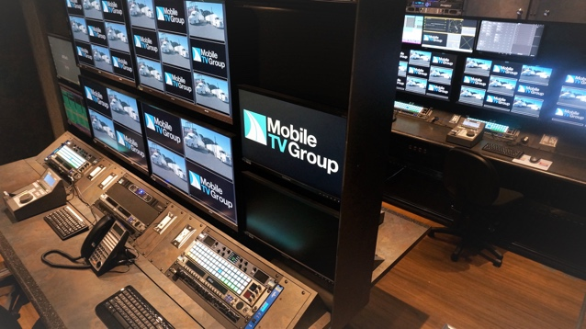
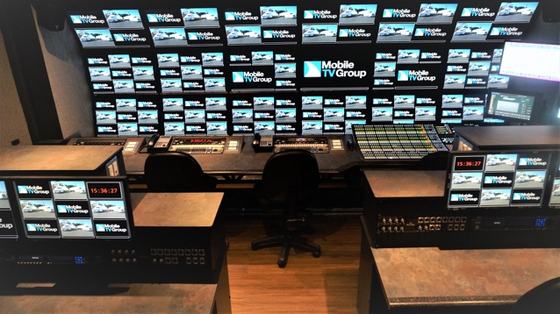
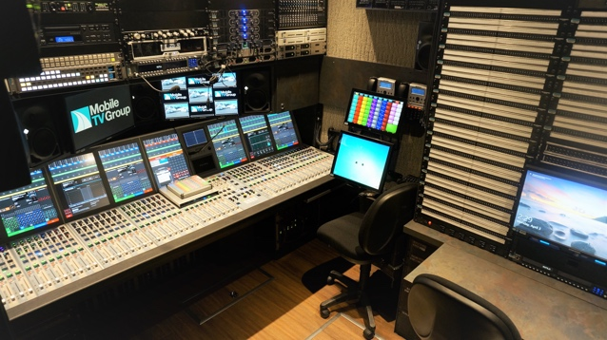
Inside Mobile Unit 44 FLEX and 44 VMU
Take a 360 tour: tinyurl.com/mtvg360tour

Slide 6




Camera Operators
Cameras
Servers/Router/Switcher
Engineers
Producer/Director/Operators
Keyboards, Control Panels
Network Origination
Technicians
Mobile Unit
Venue
Original
At-Home
Approach
Camera Operators
Cameras
Producer/Director/Operators
Keyboards, Control Panels
Servers/Router/Switcher
Engineers
Network Origination
Technicians
Venue
Network
MTVG
Approach
Camera Operators
Cameras
Servers/Router/Switcher
Engineers
Producer/Director/Operators
Keyboards, Control Panels
Network Origination
Technicians
Venue
Venue or Anywhere
Anywhere

