Slide 1
The Earliest Idea for an
Electronic Camera?
Did a 15-year-old Australian Beat Everyone Else
by At Least Seven Years?
these slides are at bit.ly/1870camera

Slide 2
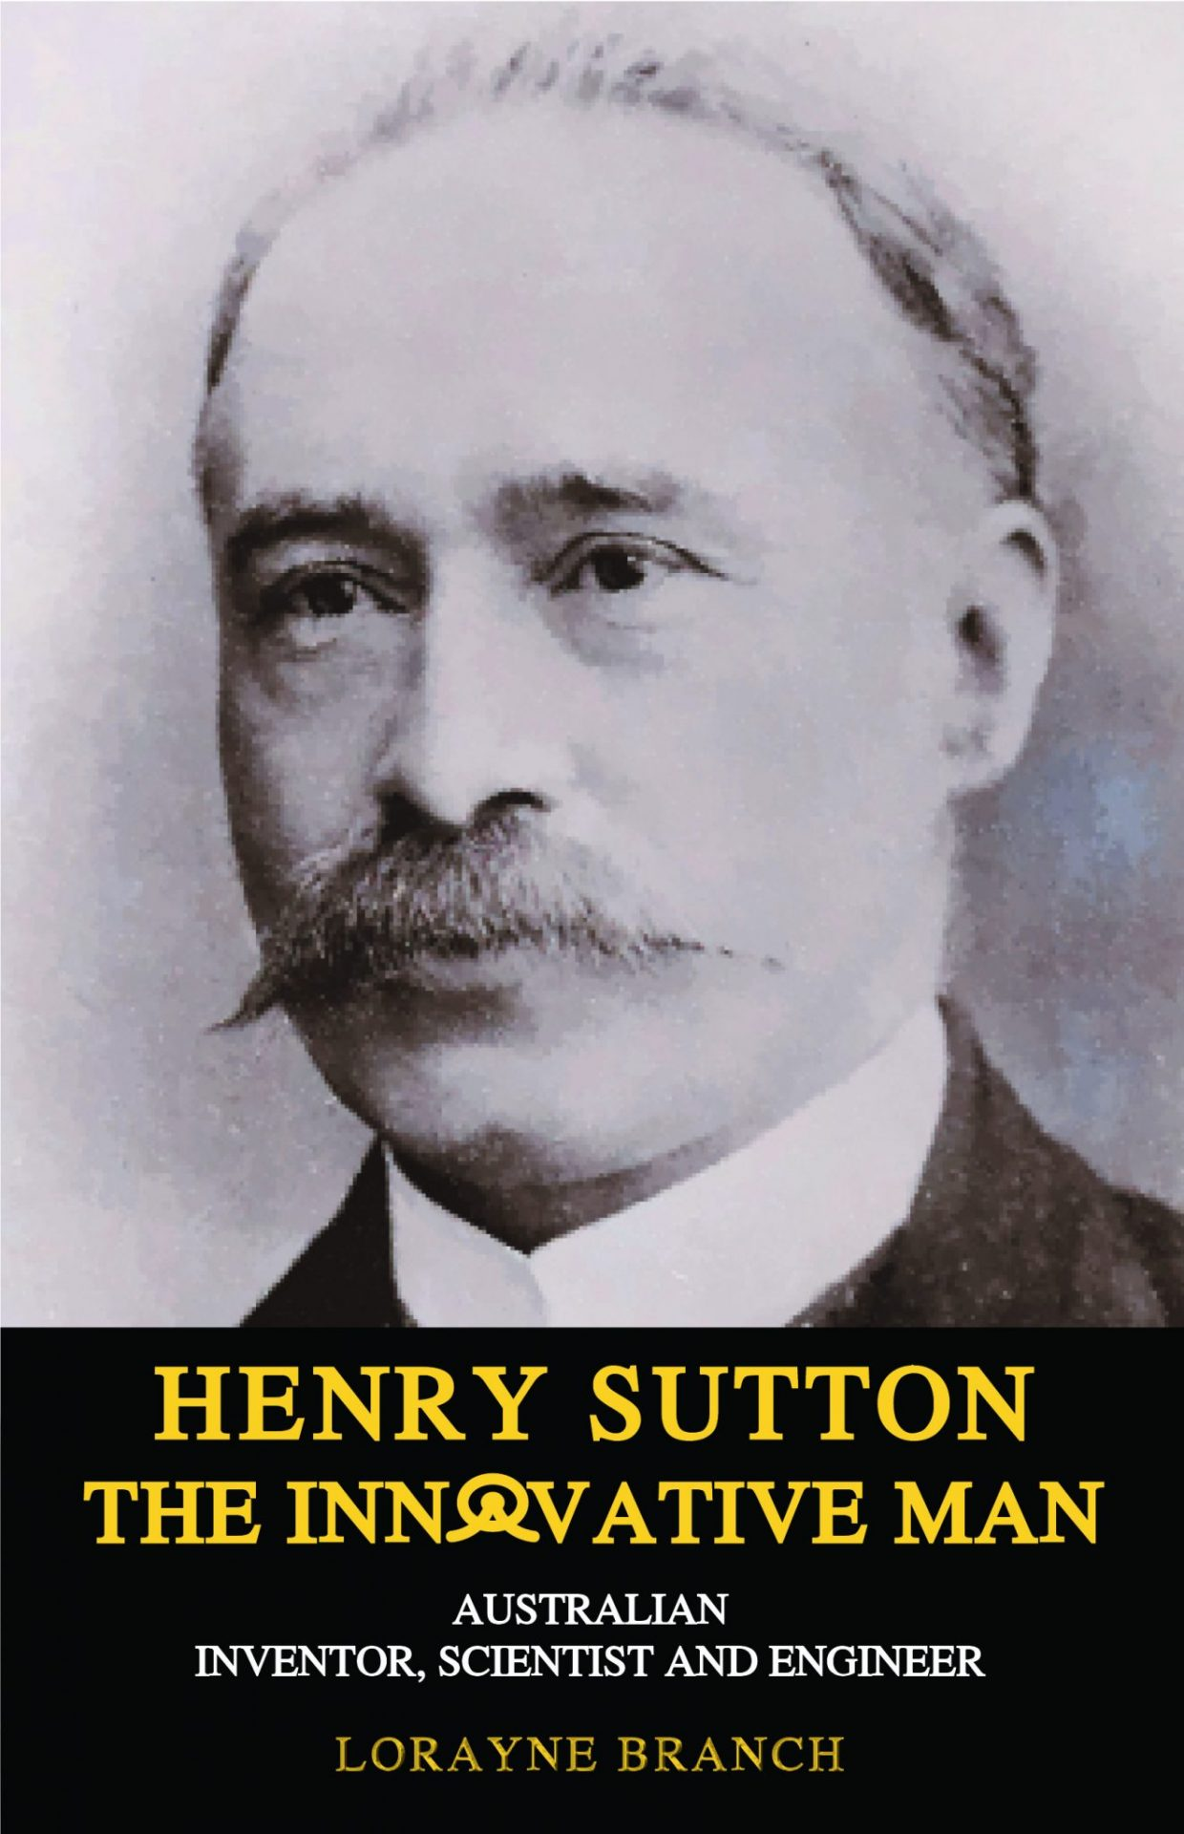
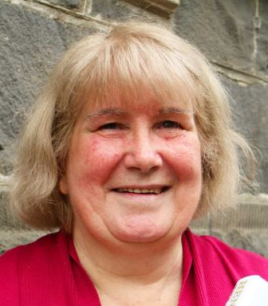
New Book
published in December
the author is the subject’s great granddaughter
  disclosure:
  I contributed
  (financially
  and with info)
  to the book

Slide 3
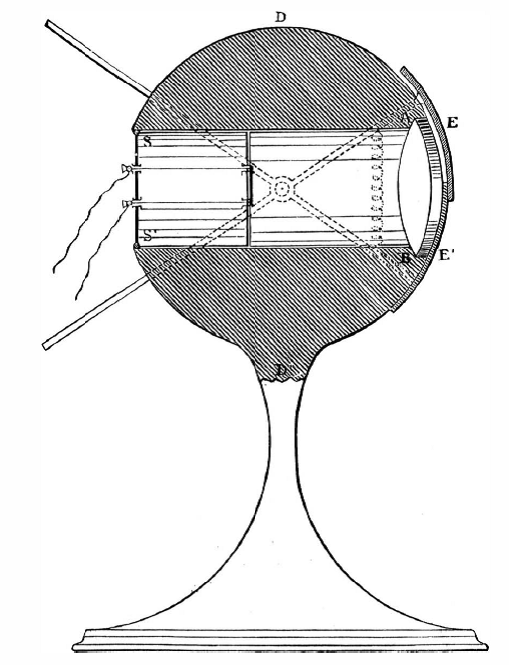
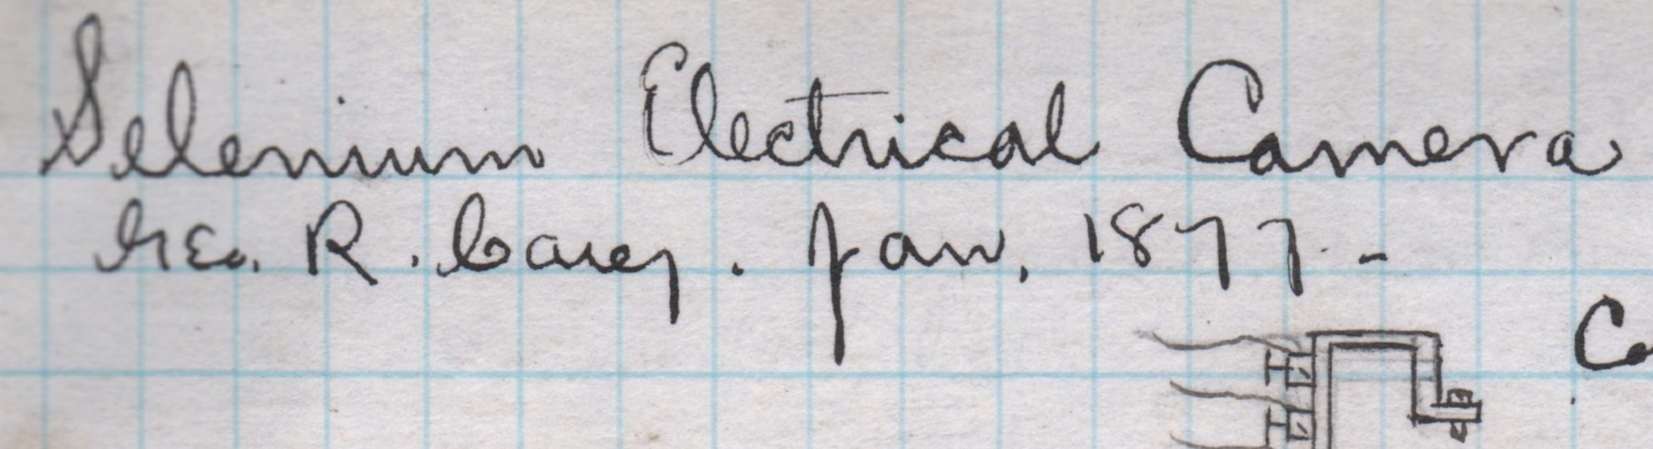
Previously from Me
many suggestions of crystal balls, magic mirrors, and the like throughout history but no cameras until 1877
researchers in France, Italy, Poland, Portugal, UK, & U.S. all began work on electronic cameras in 1877, based on a Siemens photometer called an “artificial eye” in 1876, itself based on the 1873 publication of
the discovery of photoconductivity
Scientific
American
Dec. 9, 1876
p. 374
courtesy Karpeles Manuscript Library Museums

Slide 4
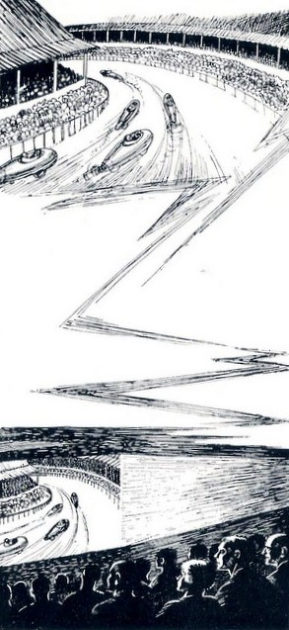
From the New Book
15-year-old Henry Sutton proposed a television camera, complete with scanning, in 1870, to transmit a horserace from Melbourne to Ballarat
  info based on his younger brother Alfred’s recollection in 1927—57 years later—of what he had been told at the time
Is it possible?
car race
transmitted
live from
Australia to
London as
depicted in
The Future
by A. M. Low
Routledge 1925

Slide 5
This Much Is Known
Sutton was a brilliant inventor with patents in many fields
In 1890 he published a “feasible” system of television (called the “telephane”), based on the 1885 Nipkow disk and the 1875 Kerr effect, and said he did it in 1885
Image scanning was patented in 1843, and the photovoltaic effect was published in 1839

Slide 6
So, Maybe
these slides are at bit.ly/1870camera

